Slide 1
Smart Construction Design3D
2024.3.5 (Schedule) About the Release Version

Slide 2
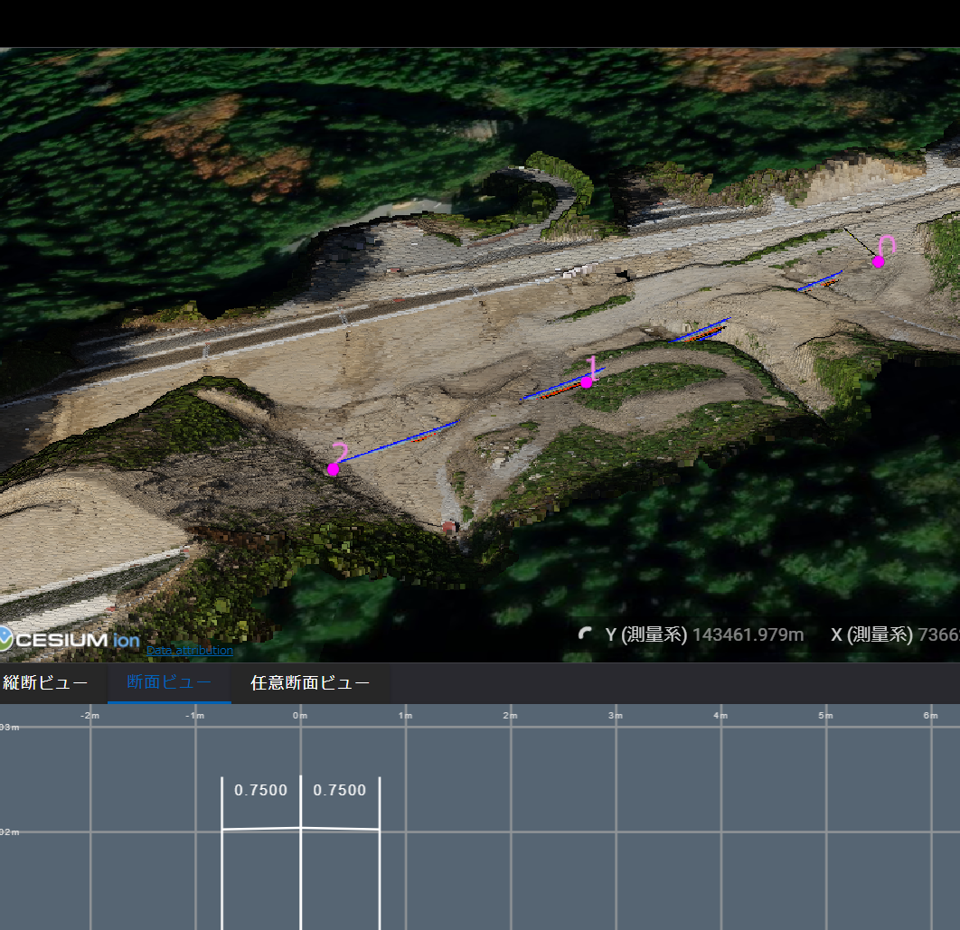
Release Item List
We are pleased to announce the release of updates to "Smart Construction Design3D" with the following schedule and content.
Due to system maintenance, the relevant services will not be available during the following dates.
(*The release schedule, time, and contents are subject to change depending on the situation. Please understand this in advance.)
Schedule： Tuesday, March 5(Japan time) 7:00 p.m. - 9:00 p.m.
NO. | Target Functions | Overview
1 | Temporary trench (Functional improvement) | Overview：Modification of cross section view function of temporary trench. Details：The display value of the temporary trench width in the cross section view has been changed from two decimal places to four decimal places.

Slide 3
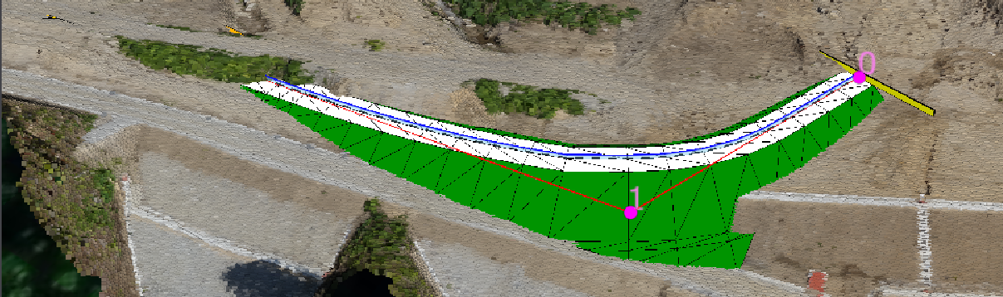
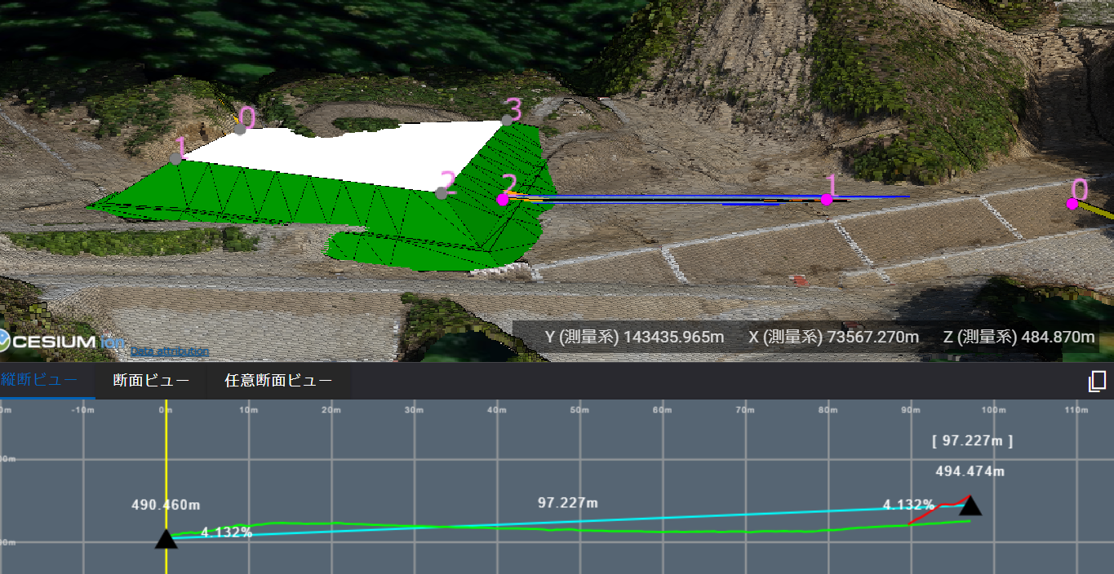
Release Item List
NO. | Target Functions | Overview
2 | TIN display (Functional improvement) | Overview：TIN display of drafted objects. Details：The TIN has been modified to always display the TIN because it is difficult to see the shape after it has been drawn.
3 | Temporary trench (Functional improvement) | Overview：Longitudinal and cross section view rehabilitation of temporary trench. Details：When a temporary trench is drawn with a flat ground, the line of the flat ground is now displayed in the longitudinal and cross section views.
Red line:
Indication of the flat ground to which the slide is attached.

Slide 4
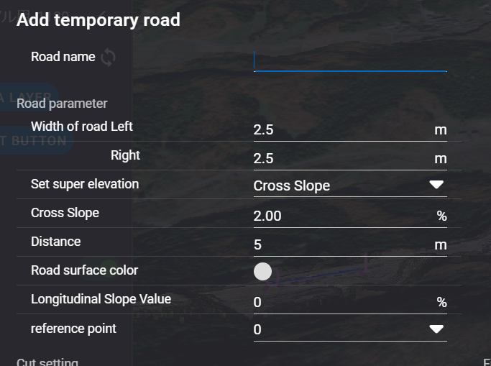
Release Item List
NO. | Target Functions | Overview
4 | Temporary road function (Functional improvement) | Overview：Revision to allow setting of longitudinal slope in temporary road drawing. Details：The ability to specify a longitudinal slope when drawing a temporary road has been improved. (It is possible to specify whether the reference point should be the start or end point of the axis.) The slope can be set by clicking the “+ ADD OBJECT BUTTON” > "Add temporary road" > Complete Plot > "Longitudinal Slope Value" and "reference point".

Slide 5
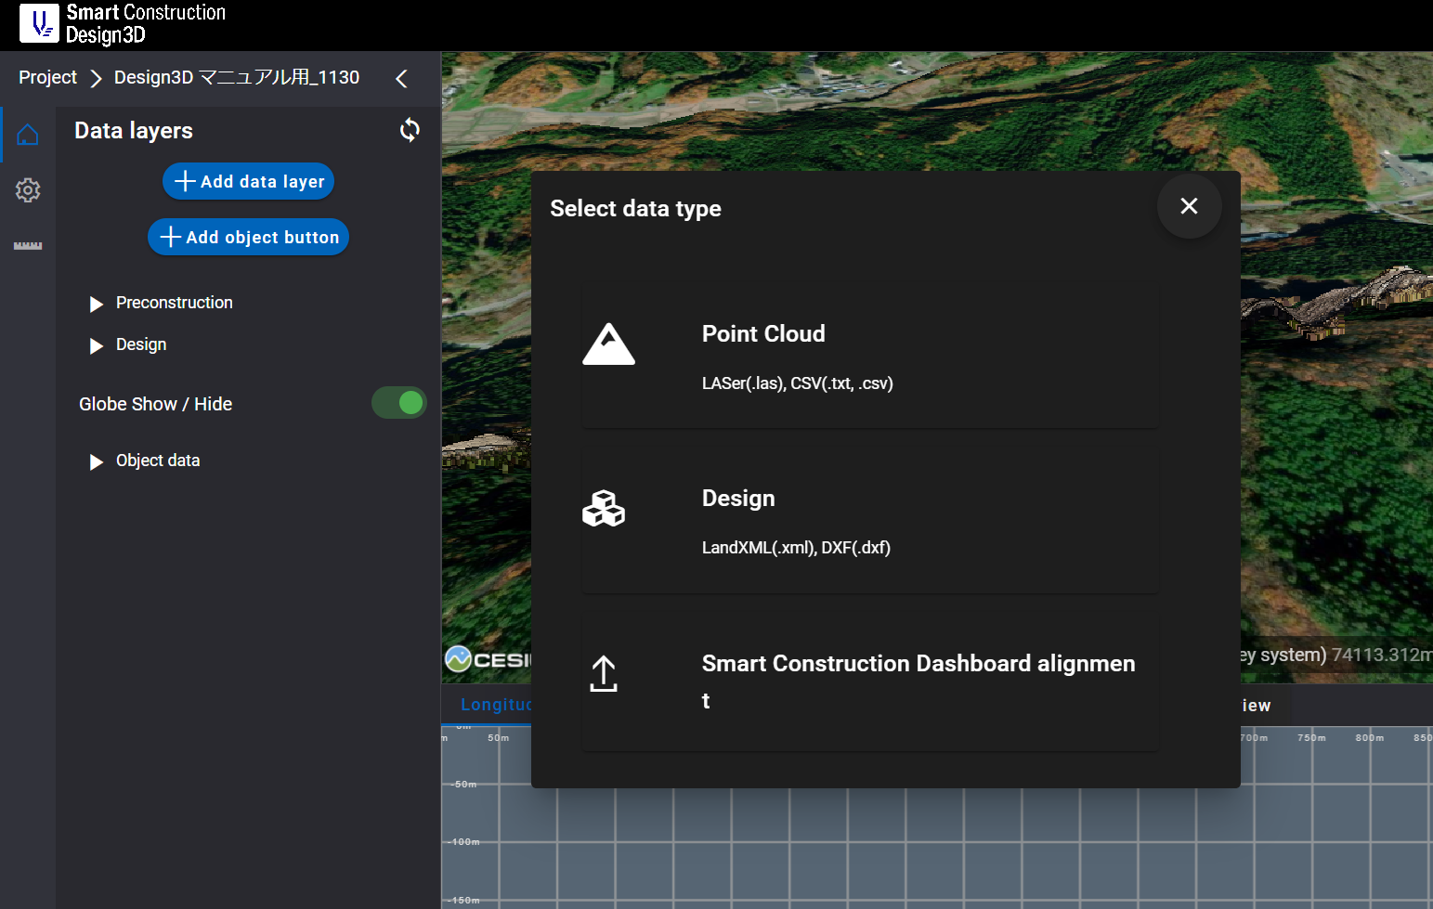
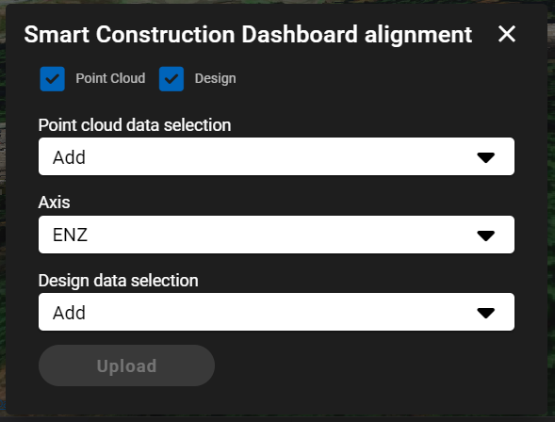
Release Item List
NO. | Target Functions | Overview
5 | SC Dashboard Linkage (Functional improvement) | Overview：Import point clouds and design data registered in SC Dashboard. Details：Modified to import point cloud data and design data existing in SC Dashboard on SC Design3D. “Add data layer”＞“Smart Construction Dashboard alignment”>Select the point cloud data and design data you wish to import into Design3D and "Upload" to complete import.

Slide 6
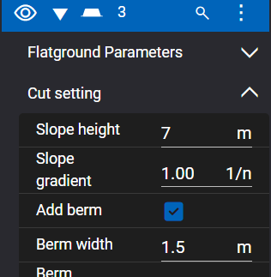
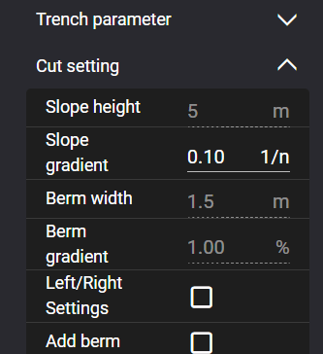
Release Item List
NO. | Target Functions | Overview
6 | Flat ground (Bug Repair) | Overview：Fixing a bug in the editing function of the flat ground. Details：A problem has been corrected in which the "Berm width" could be edited even if it was set to "no Add berm" in the flat field editing.
7 | Temporary trench (Bug Repair) | Overview：Fixing a bug in the editing function of the temporary trench. Details：A problem has been corrected in which the "Slope gradient" of the cut soil setting could be edited even when the "Left/Right settings" was enabled when editing temporary trench.

Slide 7
Release Item List
NO. | Target Functions | Overview
8 | Object mapping (Functional improvement) | Overview：Object drafting and display problems. Details：A problem that prevented the drawing and display of objects associated with point cloud data from sites older than August has been corrected.
9 | Overseas coordinate system(Functional improvement) | Overview：Fixed a problem that caused a conversion error in point cloud upload when using 3D coordinate system with overseas coordinates. Details：The conversion error that occurred when uploading a point cloud with a 3D coordinate system using UK's 7953 without vertical information has been corrected.

Slide 8
EOF

