Slide 1
Smart Construction Design3D 2023.7.27 (Schedule) About the Release Version

Slide 2
Release Item List
We are pleased to announce the release of updates to "Smart Construction Design3D" with the following schedule and content.
Due to system maintenance, the relevant services will not be available during the following dates.
(*The release schedule, time, and contents are subject to change depending on the situation. Please understand this in advance.)
Schedule： Thursday, July 27 (Japan time) 6:00 p.m. - 8:00 p.m.

Slide 3
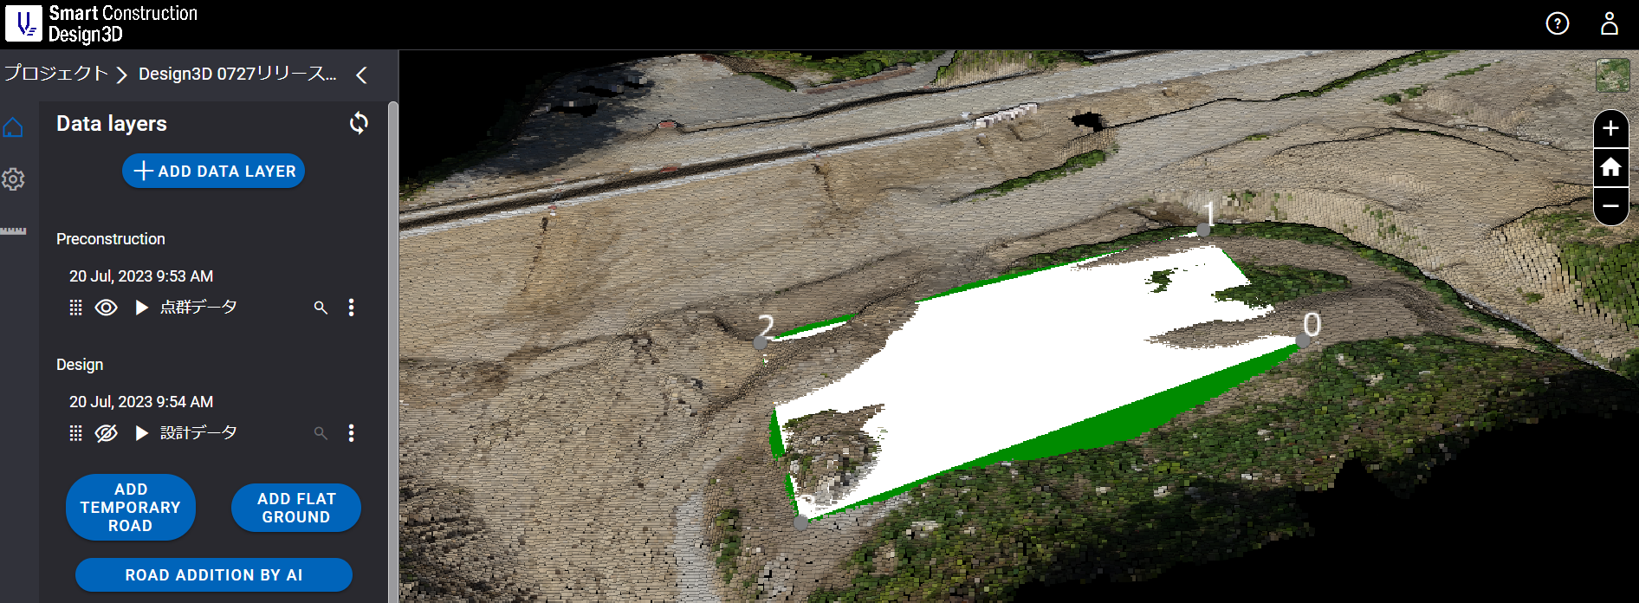
Release Item List
NO. | Target Functions | Overview
2 | Drawing Function (Function Modification) | Overview：Addition of the function of drawing a Flat Ground. Details：A function to draw a Flat Ground has been added. It has been modified so that you can draw a Flat Ground by clicking Add Flat Ground, adding 3 or more points, and setting the conditions.（See manual for details.）
リリース項目一覧
①ADD FLAT GROUND
②Click on the plotted area
③Set flat ground name and conditions and add

Slide 4
Release Item List
NO. | Target Functions | Overview
3 | Server Error (Bug Repair) | Overview：Fixed a bug that caused a server error when uploading design data. Details：When uploading design data, pressing the "Upload" button repeatedly caused a 504 error screen to be fixed.
4 | Parameter Setting(Bug Repair) | Overview：Fixed an issue where temporary roads could not be edited when the coordinate system was changed. Details：Fixed an issue where if you change the coordinate system on a created site and press Edit, the message "○○ (yourself) is currently editing. Please restart editing after a while" is displayed and editing becomes impossible. it was done.
5 | Status Display(Bug Repair) | Overview：Fixed a bug that the site list was not displayed when there were many registered sites. Details：Fixed a bug where the site list was not displayed for accounts with more than 4000 sites.

Slide 5
EOF

