Slide 1
Smart Construction Design3D 2023.11.9 (Schedule) About the Release Version

Slide 2
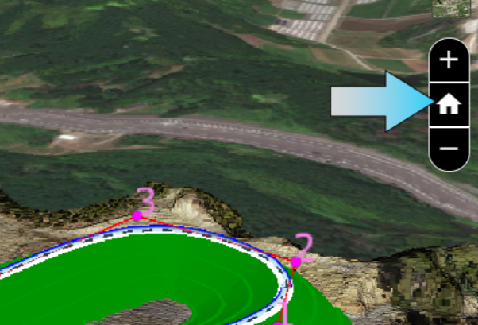
Release Item List
We are pleased to announce the release of updates to "Smart Construction Design3D" with the following schedule and content.
Due to system maintenance, the relevant services will not be available during the following dates.
(*The release schedule, time, and contents are subject to change depending on the situation. Please understand this in advance.)
Schedule： Tuesday, November 9 (Japan time) 6:00 p.m. - 8:00 p.m.
NO. | Target Functions | Overview
1 | Home button Abolished (Functional modification) | Overview：Home button Abolished. Details：The home button has no function and is deemed unnecessary and the home button will be eliminated.
Abolished

Slide 3
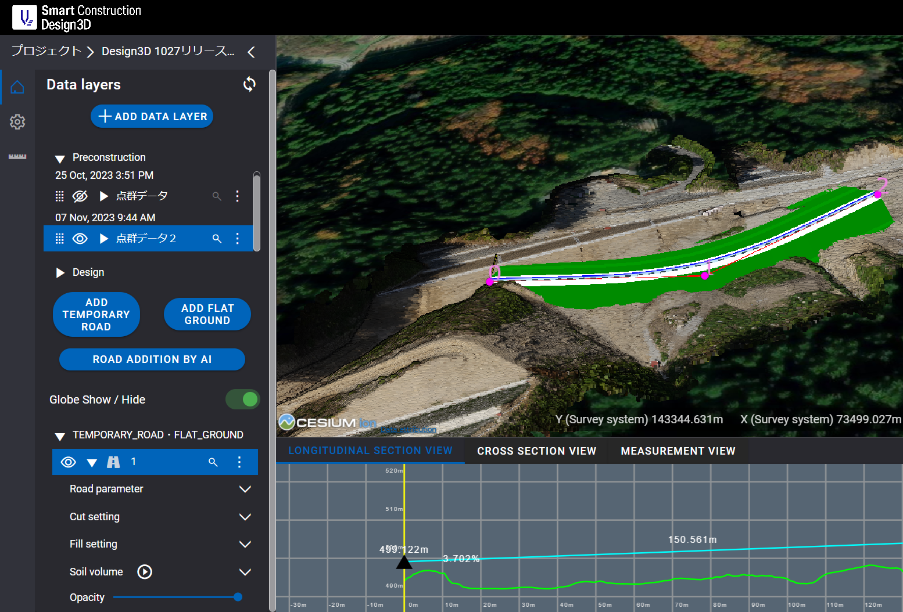
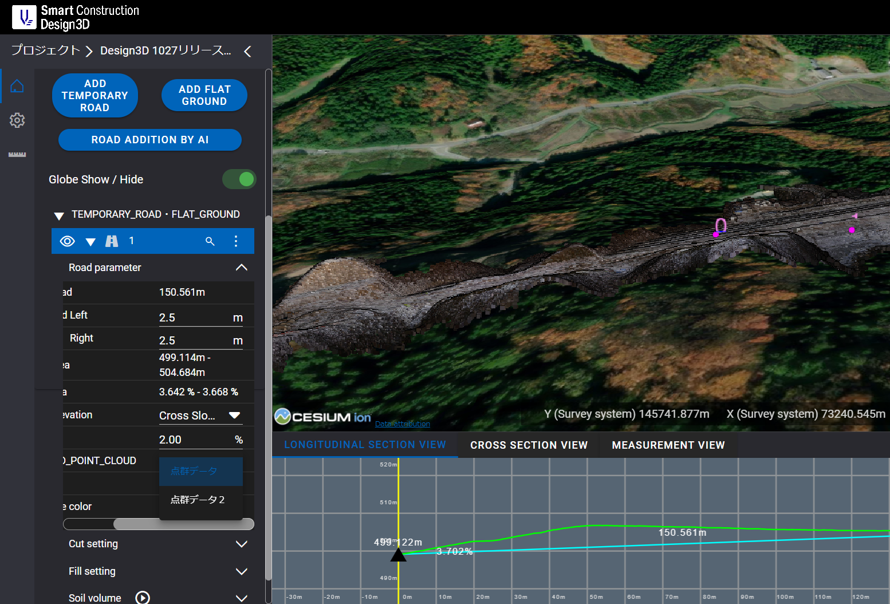
Release Item List
NO. | Target Functions | Overview
2 | Sliding point cloud change function (Functional modification) | Overview：Added the ability to change the destination when multiple point clouds exist. Details：When multiple point cloud data are uploaded, a function has been added to change the point cloud sliding destination. The sliding point group can be changed from "Temporary Road and Plain Plotting" > Edit > "ASSOCIATED_POINT_CLOUD" in the sidebar.
From Editing
Check the sidebar
Upload multiple point cloud data
Select the point group to be changed
from the "ASSOCIATED_POINT_CLOUD".

Slide 4
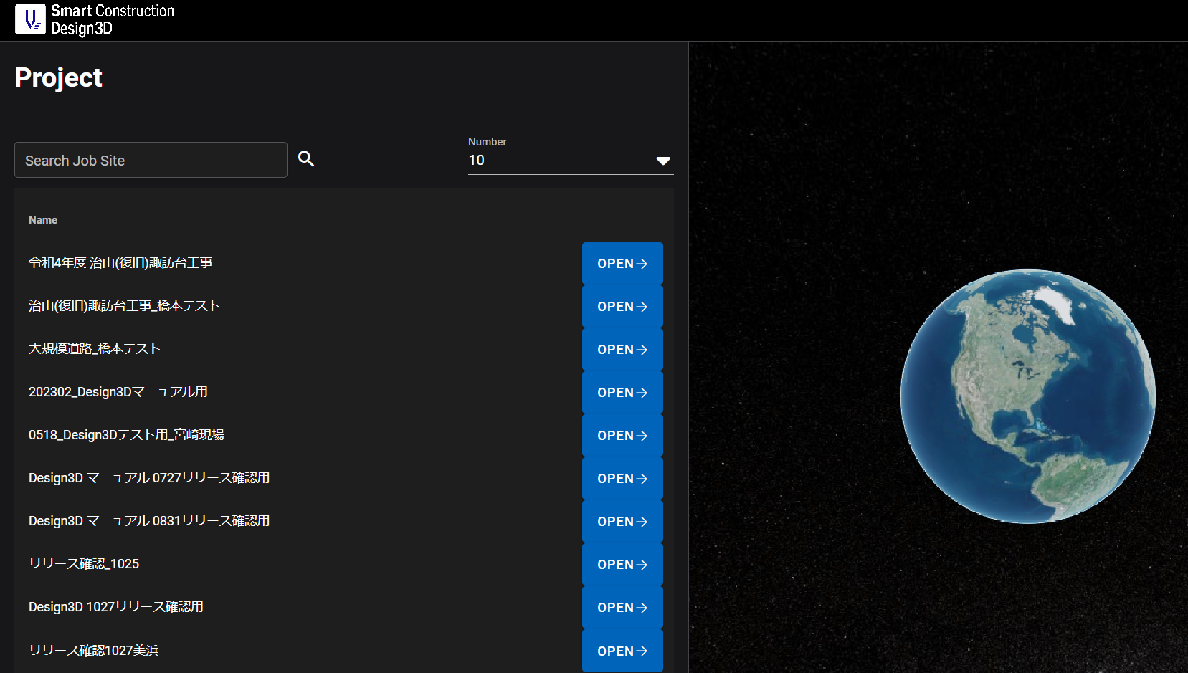
Release Item List
NO. | Target Functions | Overview
3 | Failure of site list display (Bug Repair) | Overview：Fixing a bug that prevented the site from opening from the project list. Details：A bug has been fixed in which leaving the Project List screen and then pressing the Open Site button would not open the site, but would return to the Project List screen again. There were two conditions under which the bug occurred ①When there is excessive load on the browser side (heavy data, network disconnection) ②When not operated for a certain period of time (in the case of Chrome, it takes 5 minutes to refresh)
4 | Temporary Road Drawing Defects (Bug Repair) | Overview：Fixed a problem in which the design plane was not displayed on the longitudinal section view/cross section view when a short road was depicted. Details：A problem that prevented the design plane from being displayed on the longitudinal section view/cross section view when depicting a road with a pitch shorter than the set pitch has been corrected.
Bug with "Open" not opening the site.

Slide 5
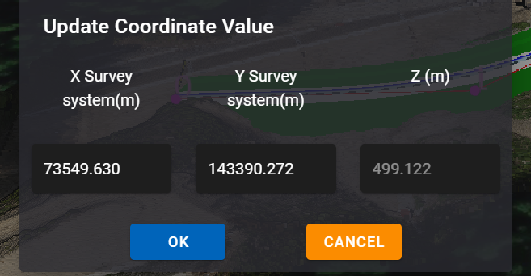
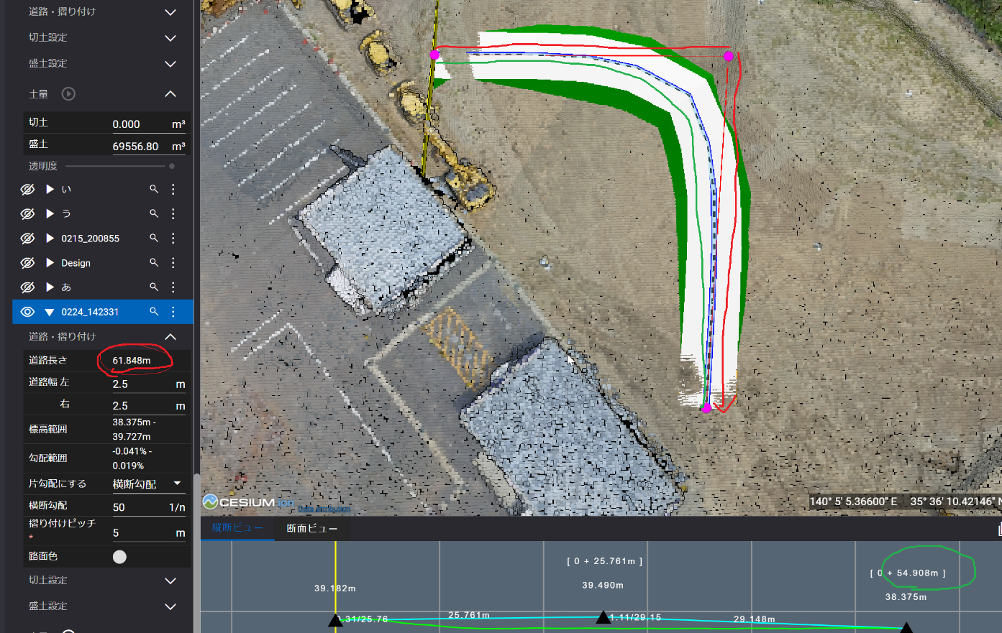
Release Item List
NO. | Target Functions | Overview
5 | Browser Behavior Glitches (Bug Repair) | Overview：Fixed a bug that the operation of coordinate input or canceling coordinate input was slow and the browser froze. Details：In hypothetical road and level field editing, a bug has been fixed in which pressing the Cancel button in the coordinate input or coordinate input screen would slow down the operation and cause the browser to freeze.
6 | Display distance mismatch (Bug Repair) | Overview：Fixed an issue where the road length on the sidebar did not match the total distance on the longitudinal view. Details：An issue where the road length on the sidebar did not match the total distance on the longitudinal view has been corrected so that both are the distance of the centerline of the road.
・Decide by inputting coordinates
・Cancel coordinate input
Browser freezes at the above actions
It was a mismatch

Slide 6
EOF

