Slide 1
Smart Construction Design3D 2024.1.30 (Schedule) About the Release Version

Slide 2
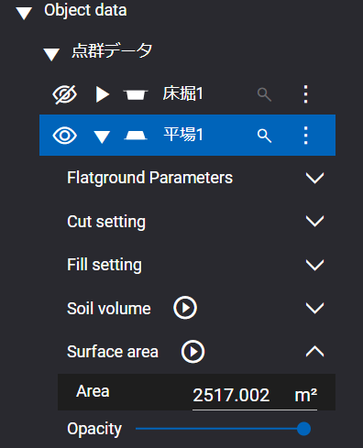
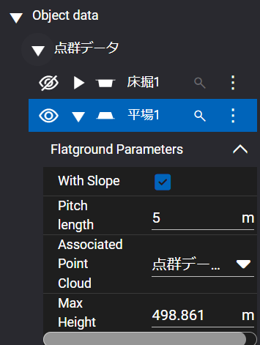
Release Item List
We are pleased to announce the release of updates to "Smart Construction Design3D" with the following schedule and content.
Due to system maintenance, the relevant services will not be available during the following dates.
(*The release schedule, time, and contents are subject to change depending on the situation. Please understand this in advance.)
Schedule： Tuesday, January 30(Japan time) 7:00 p.m. - 9:00 p.m.
NO. | Target Functions | Overview
1 | Flat ground (Functional improvement) | Overview：Flat ground function added. Details：The following two features have been added for flat ground.
①Surface area measurement
② Height setting by coordinate values
Press to calculate surface area.
Can be set numerically.

Slide 3
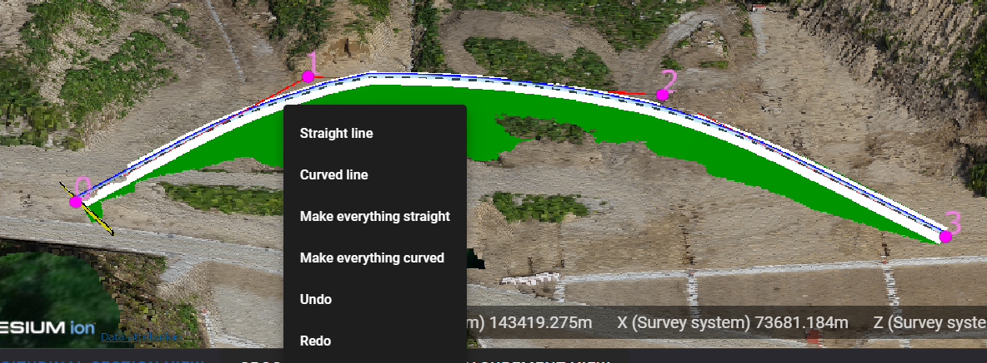
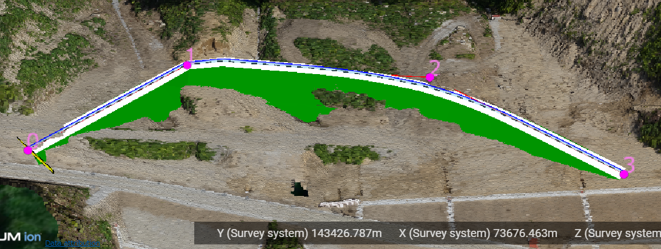
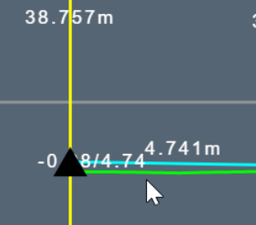
Release Item List
NO. | Target Functions | Overview
2 | Temporary road function (Functional improvement) | Overview：Additional temporary road features. Details：Added the ability to change between points on a specified temporary road to “Straight line" or “Curved line" and the entire temporary road to “Make everything straight" or "Make everything curved". It can be changed by right-clicking on the road surface in the edit state.
3 | Longitudinal and cross-sectional views (Bug Repair) | Overview：Difficult to see or not see the values on the longitudinal and cross-sectional view screens. Details：A problem in the longitudinal and cross-sectional views, in which ▲ and values are covered and difficult to see, has been corrected.

Slide 4
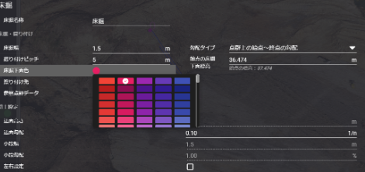
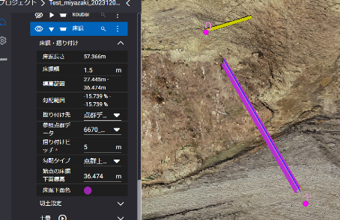
Release Item List
NO. | Target Functions | Overview
4 | Color Change (Bug Repair) | Overview：Repair of defects that do not change the color of the underside of the temporary trench. Details：A problem with changing the color of the underside of a temporary trench when adding a new temporary trench has been corrected.
5 | Exclusive control (Bug Repair) | Overview：Exclusion control defect repair. Details：A problem has been corrected in which starting to edit another object in edit mode (or exiting the site) would put the original object in view mode, but prevent other users from editing it.

Slide 5
Release Item List
NO. | Target Functions | Overview
6 | Design data (Bug Repair) | Overview：Bug fix on design data deletion Details：A problem has been corrected in which design data can be deleted even when there is object data connected to the design data, so that all connected objects disappear when the design data is deleted. The same check process as for point clouds is performed, and if there is a connected object, the message "Cannot be delete because the specified object exists" will appear.

Slide 6
EOF

