Slide 1
Smart Construction Design3D
2024.4.30 (Schedule) About the Release Version

Slide 2
Release Item List
We are pleased to announce the release of updates to "Smart Construction Design3D" with the following schedule and content.
Due to system maintenance, the relevant services will not be available during the following dates.
(*The release schedule, time, and contents are subject to change depending on the situation. Please understand this in advance.)
Schedule： Tuesday, April 30(Japan time) 7:00 p.m. - 9:00 p.m.
NO. | Target Functions | Overview | Details
1 | Temporary Road Drawing (Functional improvement) | Added a function to specify the slope of a temporary road in a longitudinal view. | When a slope is double-clicked on a section in the editing state, the slope can now be entered directly or specified using the up/down buttons.
2 | Temporary Road Drawing (Functional improvement) | Modification to allow specification of vertical slope from dialog when creating temporary roads. | In the drawing of temporary roads, the slope of the longitudinal section can now be specified from a dialog box.
3 | Asset Linkage (Functional improvement) | When "las" is selected for point cloud data in asset linkage, axis setting is no longer required. | If a las file is selected for point cloud data selection, axis settings are hidden because they are not needed; if a txt file is selected, axis settings are displayed.
4 | Asset Linkage (Functional improvement) | Only files supported by Design3D can be used for point cloud data in asset linkage. | The data displayed in the point cloud data list has been modified to only include file extensions that are supported by Design3D.
5 | Asset Linkage (Bug Repair) | Point cloud data cannot be acquired by asset linkage. | Fixed a bug so that point cloud data can be obtained by setting not only the Survey folder in the FileManager but also the data in the Preconstruction folder as the target of asset linkage.
6 | Asset Linkage (Bug Repair) | Unnecessary numbers are displayed in data names when linking assets. | Modified to display the name on the Dashboard after selecting and uploading point cloud data for asset linkage.。

Slide 3
Release Item List
NO. | Target Functions | Overview | Details
7 | Detachment function (Bug Repair) | Correction of a problem in which the sliding reference point returns to its original position when a temporary road is merged. | When a temporary road was merged with a level area or a road and the screen was reloaded, the reference point that had been slid back to the clicked location was fixed.
8 | Unified button size (Bug Repair) | Button size mismatch. | The action button sizes were inconsistent, so they have been modified to be consistent in size.
9 | Site Access (Bug Repair) | Error screen and site name are not displayed when entering a site to which you do not have access rights via a direct link. | A modification has been made so that if you enter a site to which you do not have access rights via a direct link, you will see a screen with an error message and not a Design3D screen.

Slide 4
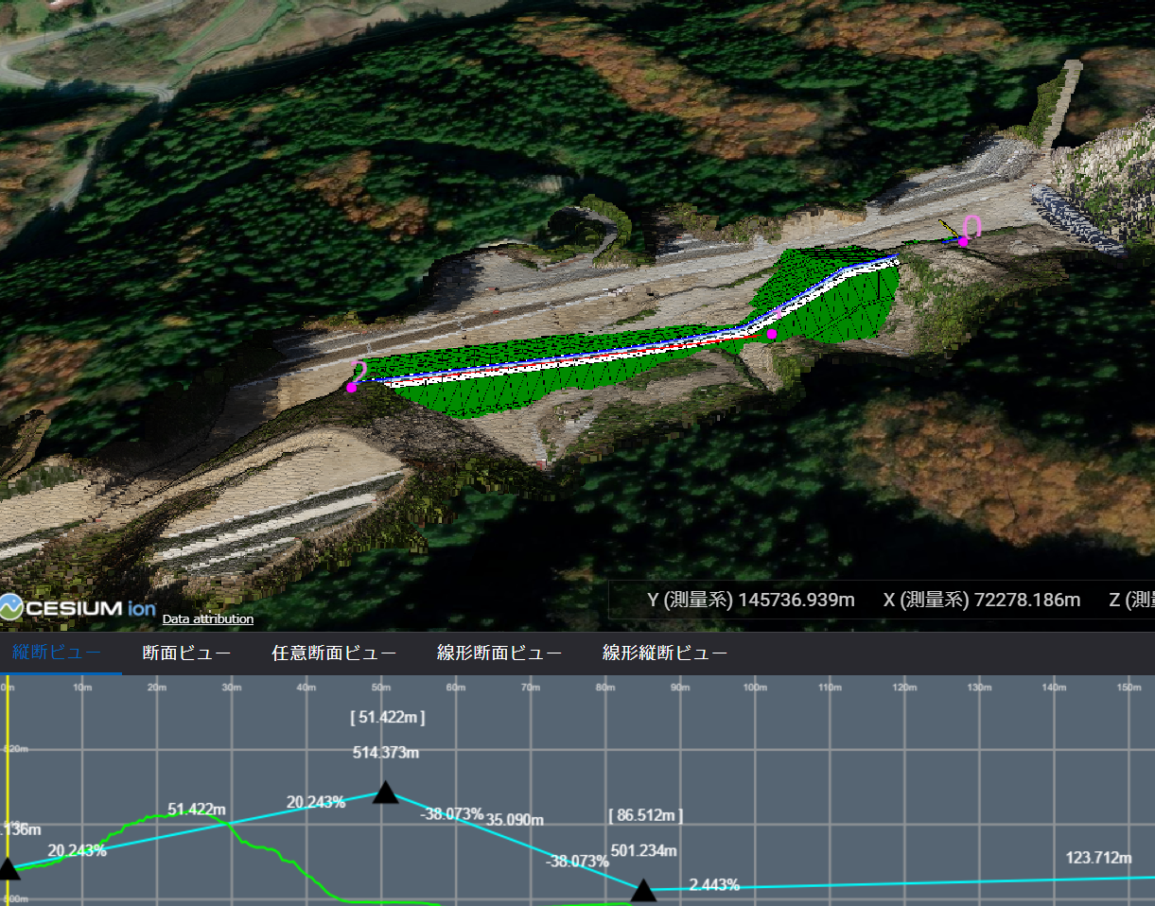
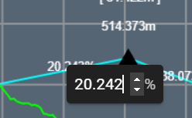
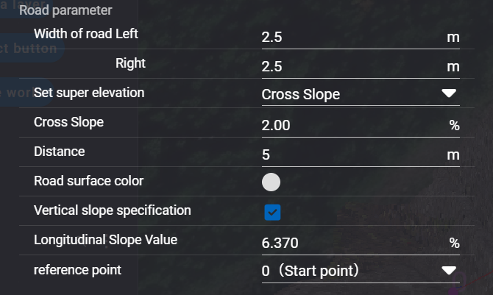
Release Item List
NO. | Target Functions | Overview
1 | Temporary Road Drawing (Functional improvement) | Overview：Added a function to specify the slope of a temporary road in a longitudinal view. Details：When a slope is double-clicked on a section in the editing state, the slope can now be entered directly or specified using the up/down buttons.
2 | Temporary Road Drawing (Functional improvement) | Overview：Modification to allow specification of vertical slope from dialog when creating temporary roads. Details：In the drawing of temporary roads, the slope of the longitudinal section can now be specified from a dialog box.
Double-click on slope
・Direct input
・Up/down buttons on the
right display
・Can be set by turning on the “Vertical slope specification” in the dialog. (default is off)
・ Reference reference point can be selected from start or end point.

Slide 5
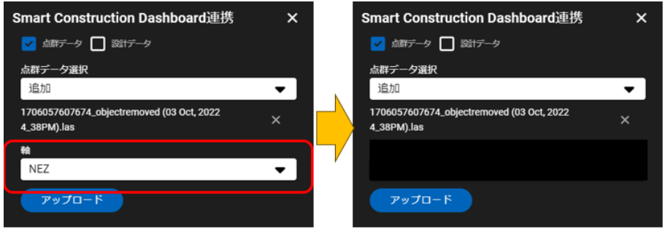
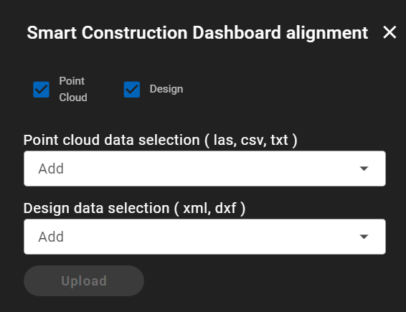
Release Item List
NO. | Target Functions | Overview
3 | Asset Linkage (Functional improvement) | Overview：When "las" is selected for point cloud data in asset linkage, axis setting is no longer required. Details：If a las file is selected for point cloud data selection, axis settings are hidden because they are not needed; if a txt file is selected, axis settings are displayed.
4 | Asset Linkage (Functional improvement) | Overview：Only files supported by Design3D can be used for point cloud data in asset linkage. Details：The data displayed in the point cloud data list has been modified to only include file extensions that are supported by Design3D.

Slide 6
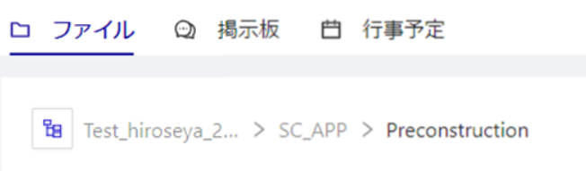
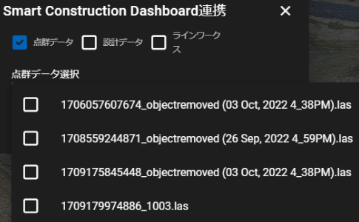
Release Item List
NO. | Target Functions | Overview
5 | Asset Linkage (Bug Repair) | Overview：Point cloud data cannot be acquired by asset linkage. Details：Fixed a bug so that point cloud data can be obtained by setting not only the Survey folder in the FileManager but also the data in the Preconstruction folder as the target of asset linkage.
6 | Asset Linkage (Bug Repair) | Overview：Unnecessary numbers are displayed in data names when linking assets. Details：Modified to display the name on the Dashboard after selecting and uploading point cloud data for asset linkage.
← Asset Linkage Target
Unnecessary letters in the head.

Slide 7
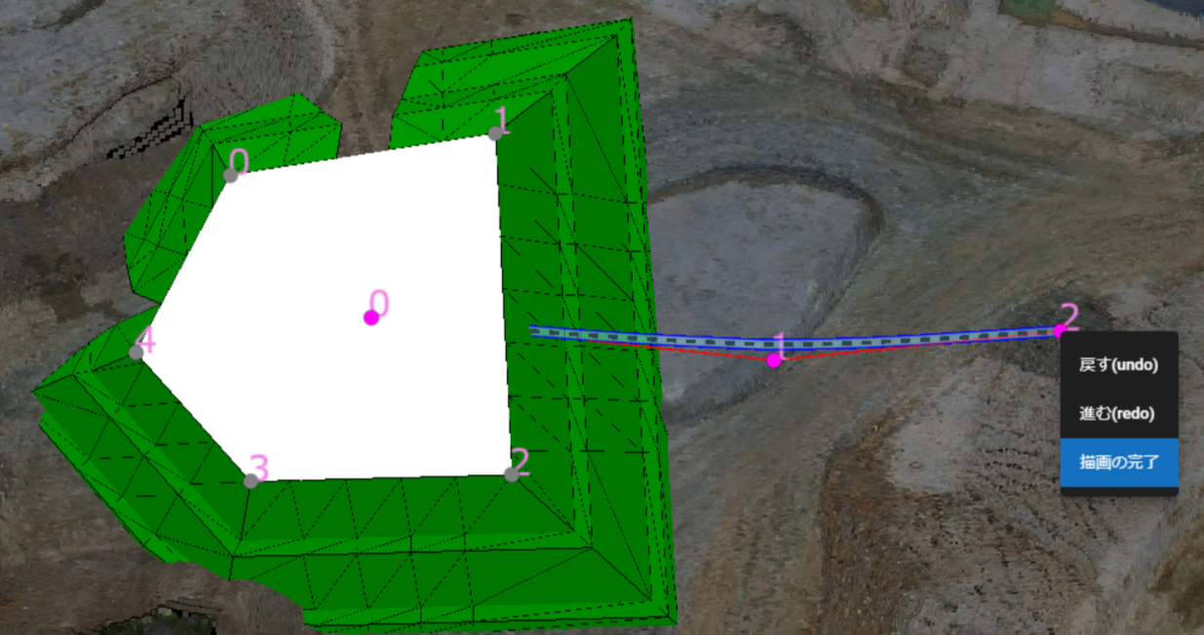
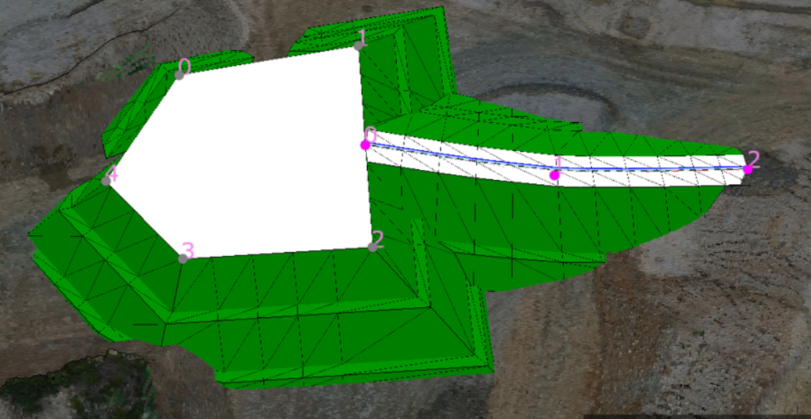
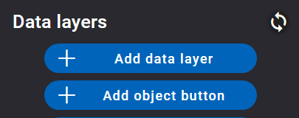
Release Item List
NO. | Target Functions | Overview
7 | Detachment function (Bug Repair) | Overview：Correction of a problem in which the sliding reference point returns to its original position when a temporary road is merged. Details：When a temporary road was merged with a level area or a road and the screen was reloaded, the reference point that had been slid back to the clicked location was fixed.
8 | Unified button size (Bug Repair) | Overview：Button size mismatch Details：The action button sizes were inconsistent, so they have been modified to be consistent in size.
【 Fault phenomenon 】
Temporary road separation.
Screen reload in disengaged state.
The reference point returns to the point clicked.

Slide 8
Release Item List
NO. | Target Functions | Overview
9 | Site Access (Bug Repair) | Overview：Error screen and site name are not displayed when entering a site to which you do not have access rights via a direct link. Details：A modification has been made so that if you enter a site to which you do not have access rights via a direct link, you will see a screen with an error message and not a Design3D screen.

Slide 9
EOF

