Slide 1
Smart Construction Design3D 2024.5.28 (Schedule) About the Release Version

Slide 2
Release Item List
We are pleased to announce the release of updates to "Smart Construction Design3D" with the following schedule and content.
Due to system maintenance, the relevant services will not be available during the following dates.
(*The release schedule, time, and contents are subject to change depending on the situation. Please understand this in advance.)
Schedule： Tuesday, May 28(Japan time) 7:00 p.m. - 9:00 p.m.
NO. | Target Functions | Overview | Details
1 | Line Works (Function addition) | Added ability to upload lineworks. | Added the ability to upload linear DXF data for 2D drawings. You can add a new layer from “+Add Data Layer” > “Lineworks” > Upload.
2 | Add Lineworks (Function addition) | Addition of line works functionality. | Added the ability to upload and arbitrarily create linear data. Select “+ Add line works” > “Upload line works” or “Linework creation”.
3 | Asset Linkage (Function addition) | Modified asset linkage to add lineworks. | The ability to add lineworks from the Smart Construction Dashboard linkage has been modified.
4 | Save configuration changes(Functional Improvement) | Save transparency and color of point cloud data and design data. | The ability to save transparency and color of point cloud data and design data has been modified.
5 | Localization Settings (Functional Improvement) | Localization settings without SC Dashboard. | Modified to allow creation of localization sites (upload of gc3 files) without going through the SC Dashboard.

Slide 3
Release Item List
NO. | Target Functions | Overview | Details
6 | Object list display (Bug Repair) | Reference point cloud data list was not displayed when editing temporary trench. | A problem has been corrected in which the reference point cloud data list would not be displayed when the sliding destination was changed from design to point cloud when editing a temporary trench.
7 | Object list display (Bug Repair) | Failure to fix decimal point display of cross-sectional slope in object list. | A bug has been corrected regarding the cross slope of temporary roads in the object list, where the display to the second decimal point was not fixed.
8 | Slope Formation (Bug Repair) | Failure to generate slopes only halfway up the slope. | A bug has been corrected where the slope did not reach the point cloud and was sometimes interrupted in the middle of the slope.
9 | Slope Formation (Bug Repair) | Failure to upload overseas coordinate point clouds converted from DXF. | A problem has been corrected in which point clouds with overseas coordinates converted and created via the SC Dashboard from DXF point clouds could cause abnormal point cloud uploads due to height map creation anomalies or height maps not being created.
10 | Temporary Trench Drawing (Bug Repair) | Failure to set cut soil color for temporary trench. | A problem that prevented the setting of the “Trench color” for the cut soil setting when adding a temporary trench has been corrected.
11 | Temporary Trench Drawing (Bug Repair) | Unknown numbers were displayed when the temporary trench was leveled. | A problem has been corrected in which an unknown number was displayed as the initial value of the reference flat data when a flat was selected as the sliding destination in the Add/Edit temporary trench function.
12 | Temporary Trench Drawing (Bug Repair) | When a curve was set to an acute angle in the temporary trench drawing, the shape of the slope was incorrect. | A problem has been corrected in which, when drawing a curve with a short distance and an acute angle and then straightening the curve, the slope shape inside the curve would be incorrect.
13 | Flat Ground Drawing (Bug Repair) | Failure to cut from the first step of the small step on the flat ground. | A problem that caused a cutout to be made from the first step of a small step when drawing a flat ground has been corrected.

Slide 4
Release Item List
NO. | Target Functions | Overview | Details
14 | Flat Ground Drawing (Bug Repair) | Failure to change the angle of small steps on a flat ground. | A problem with the angle of a small step changing in the middle of a slope has been corrected.
15 | Flat Ground Drawing (Bug Repair) | Defects that cause anomalies in shape when slopes face inward toward each other on level ground. | A problem has been corrected in which an anomaly would occur in the shape of a small step when the angle between slopes is inward in the flat ground drawing.
16 | Temporary Road Drawing (Bug Repair) | Defects in the shape of temporary roads when the curve angle is too steep. | A problem has been corrected in the drawing of temporary roads where, when the angle of a curve is steep (about 90 degrees), an anomaly occurs in the shape of the small steps of the inner slope.
17 | SIMA File (Bug Repair) | SIMA file upload error. | Files that cause an error when uploading SIMA files have been modified so that they can be uploaded normally.
18 | Exclusion Control Retrofit (Bug Repair) | Functional failure of the exclusion control. | A bug that prevented other users from editing an object in edit mode, even though the original object was in view mode when they started editing another object (or exited the site), has been fixed.

Slide 5
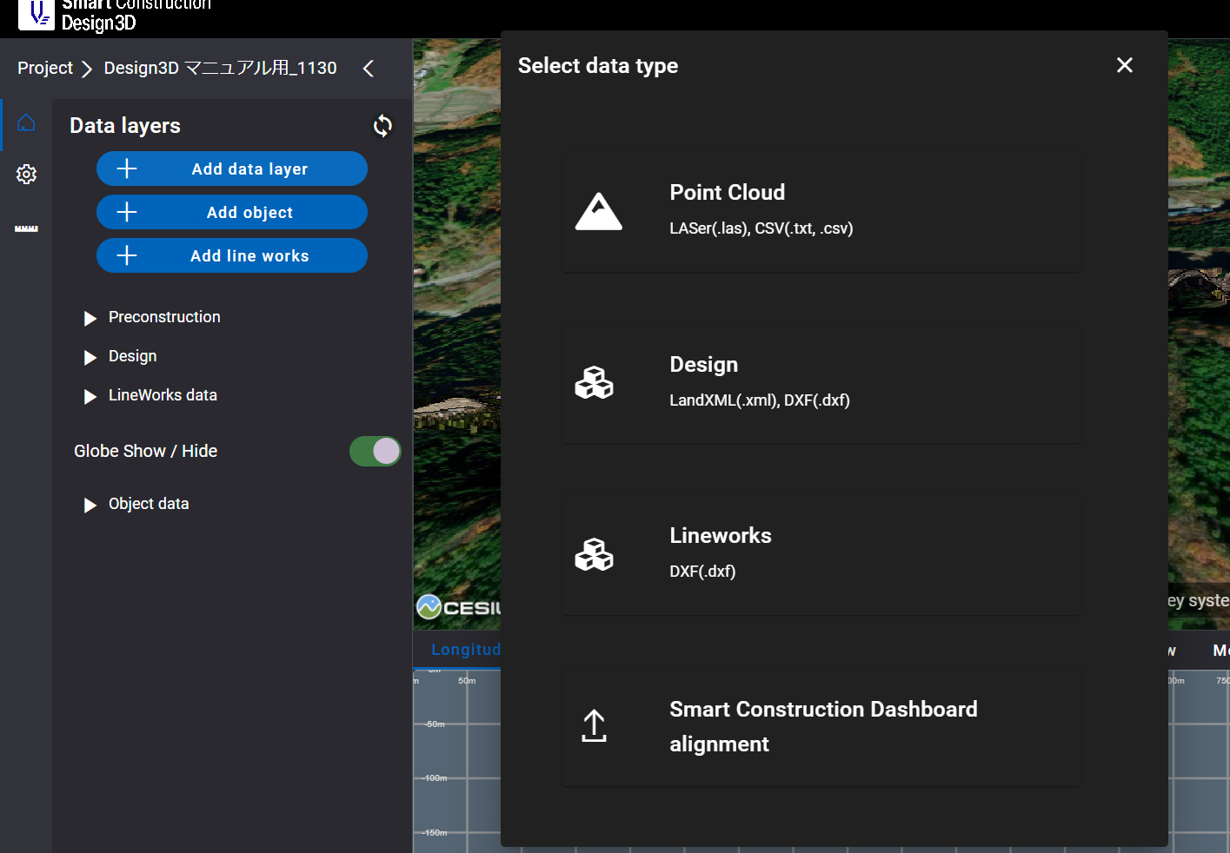
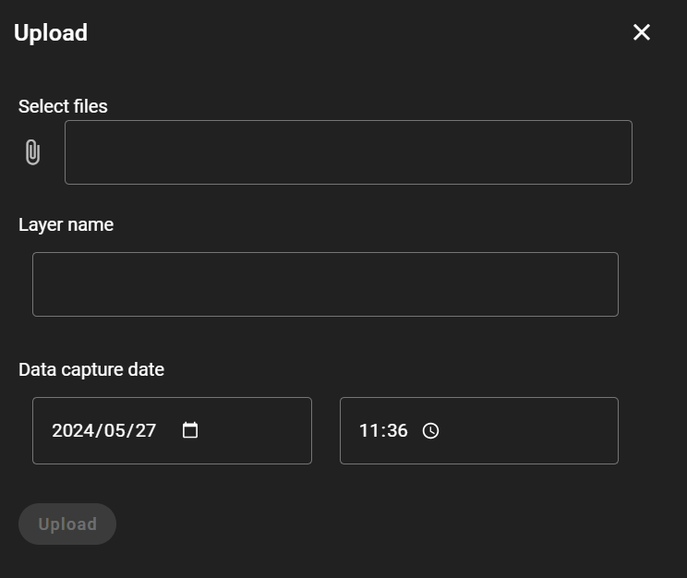
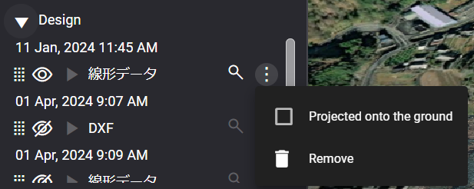
Release Item List
NO. | Target Functions | Overview
1 | Line Works (Function addition) | Overview：Added ability to upload lineworks. Details：Added the ability to upload linear DXF data for 2D drawings. You can add a new layer from “+Add Data Layer” > “Lineworks” > Upload.
Uploaded lineworks can be selected to be “projected on the ground surface”.

Slide 6
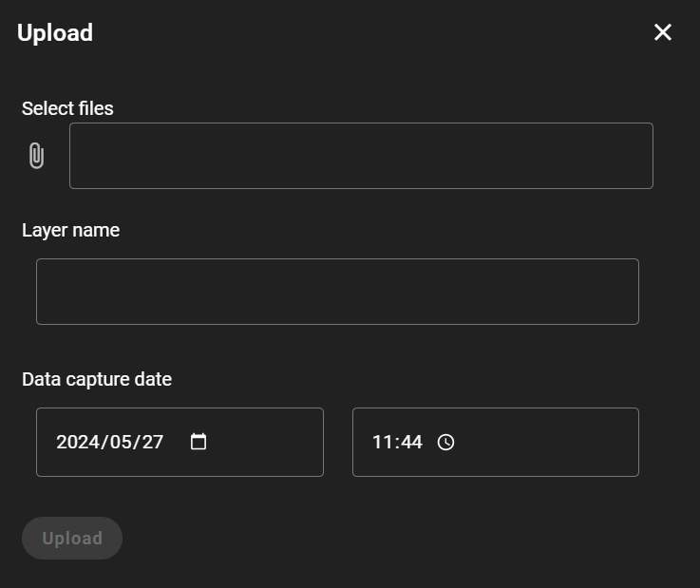
Release Item List
NO. | Target Functions | Overview
2 | Add Lineworks (Function addition) (1/4) | Overview：Addition of line works functionality. Details：Added the ability to upload and arbitrarily create linear data. Select “+ Add line works” > ① “Upload line works” or ②“Linework creation”.
①
②
① Line works upload with SIMA data.
Select a file and upload it.

Slide 7
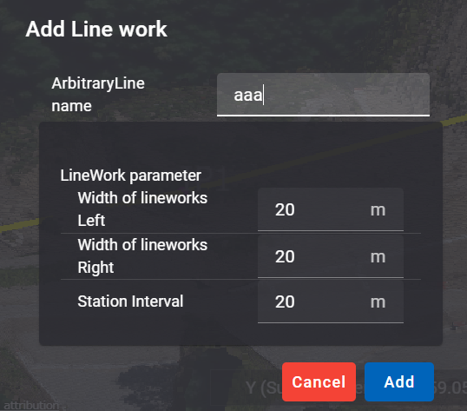
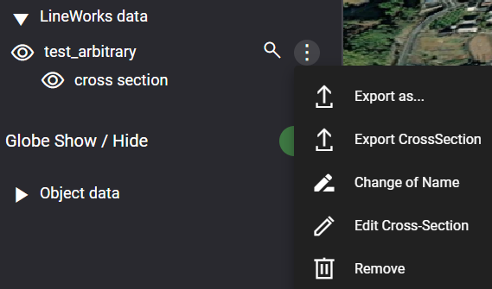
Release Item List
NO. | Target Functions | Overview
2 | Add Lineworks (Function addition) (2/4)
② Created from arbitrary line works.
Click on any point to plot and
complete drawing.
Enter linear information and add.
【Editing capability 】
Editing is possible from the three-point leader in the linear data list.
・Export as…：Capable of outputting sim files.
・Export CrossSection：Capable of outputting dxf files.
・Change of Name：Data name can be changed.
・Edit Cross-Section： Line works setpoints can be changed.

Slide 8
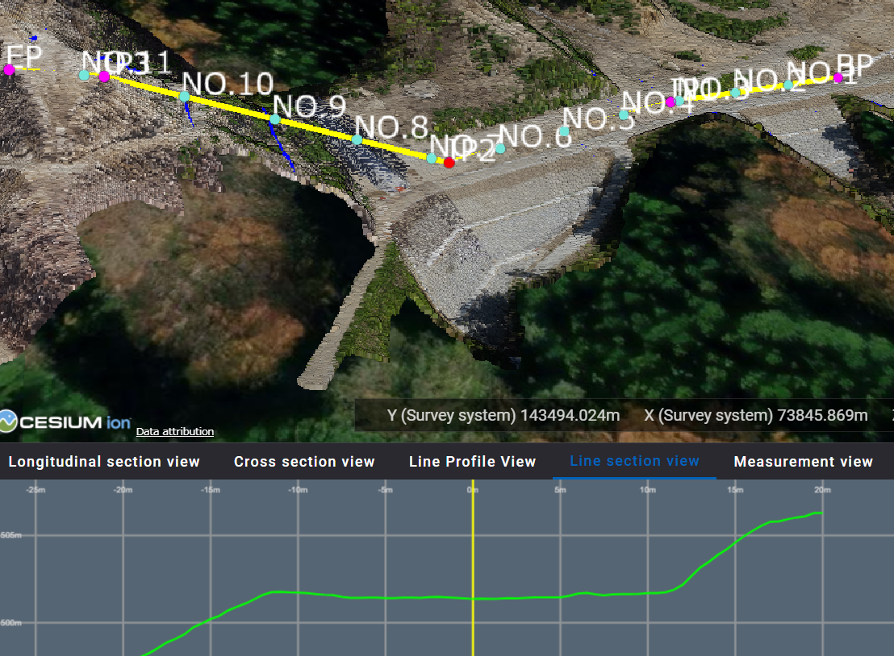
Release Item List
NO. | Target Functions | Overview
2 | Add Lineworks (Function addition) (3/4)
【Line section view】
Clicking on the ● or ● at the cross-section point in the 3D view
or on the cross-section line will display the cross-section in the
“Linear Cross Section View” on the lower scree。
(The selected cross-section point will change color to ●.)
【Line Profile View】
Green line segment: line on the ground surface.
Yellow line segment: Line of line.

Slide 9
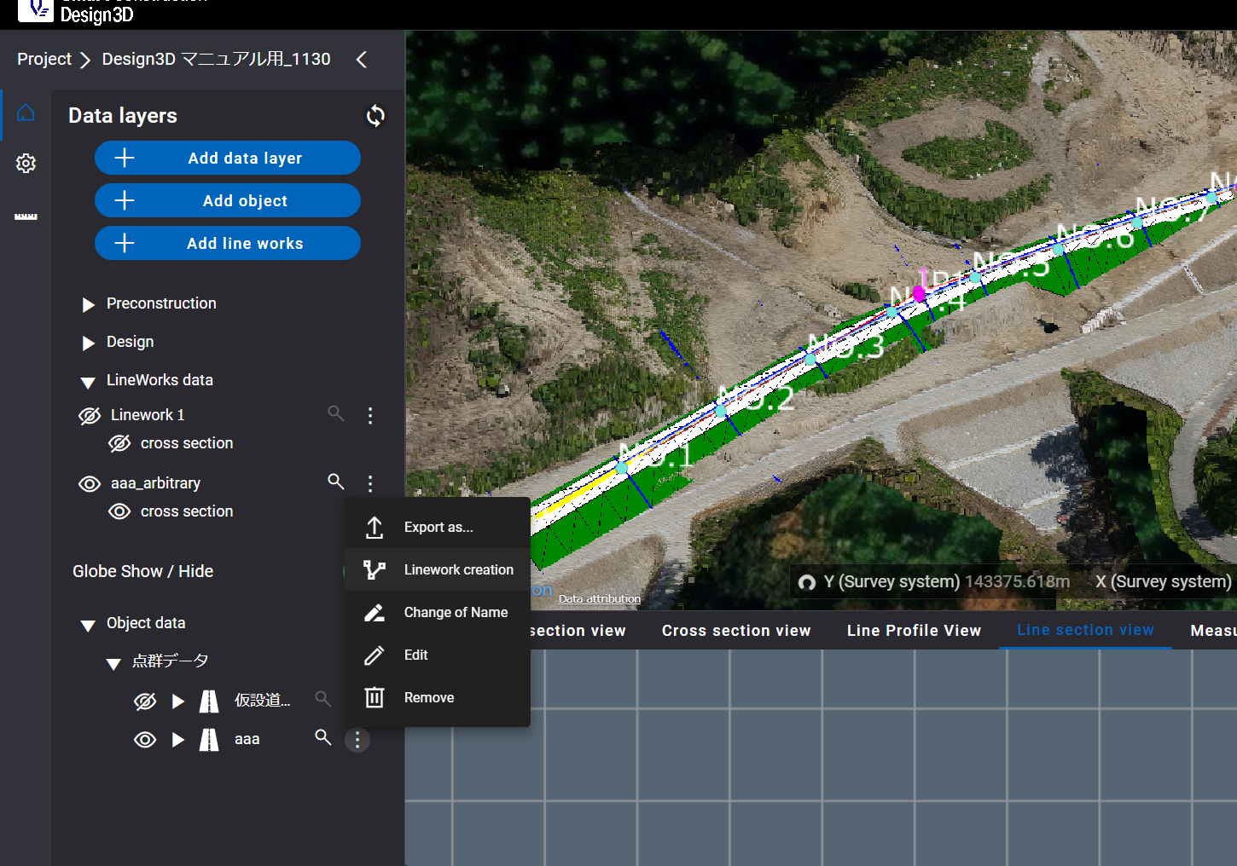
Release Item List
NO. | Target Functions | Overview
2 | Add Lineworks (Function addition) (4/4)
【 Addition of alignment from temporary road and floor excavation 】
Linear additions can be made to the plotted temporary road and floor excavation.
Pressing the three-point leader > “Linework creation” will automatically add it to the Lineworks data list.

Slide 10
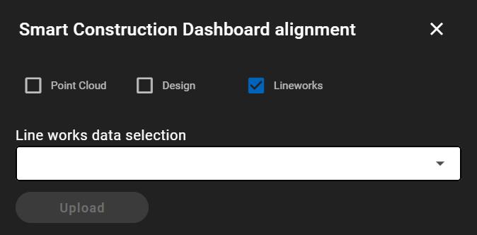
Release Item List
NO. | Target Functions | Overview
3 | Asset Linkage (Function addition) | Overview：Modified asset linkage to add lineworks. Details：The ability to add lineworks from the Smart Construction Dashboard linkage has been modified.

Slide 11
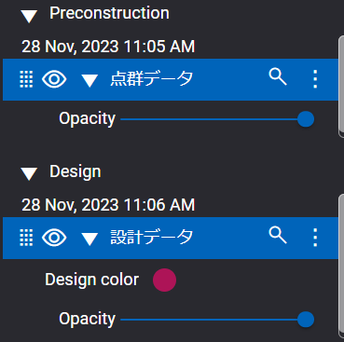
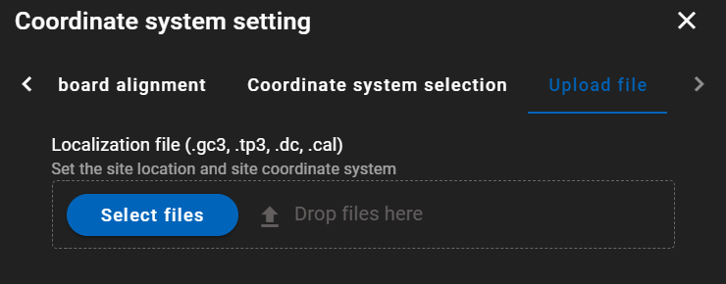
Release Item List
NO. | Target Functions | Overview
4 | Save configuration changes (Functional Improvement) | Overview：Save transparency and color of point cloud data and design data. Details：The ability to save transparency and color of point cloud data and design data has been modified.
5 | Localization Settings (Functional Improvement) | Overview：Localization settings without SC Dashboard. Details：Modified to allow creation of localization sites (upload of gc3 files) without going through the SC Dashboard.
Modified so that changed transparency and color are saved
when opening a site.

Slide 12
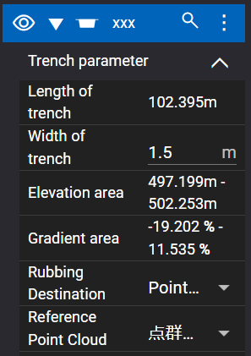
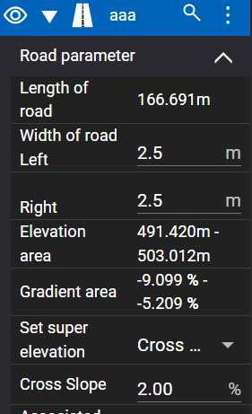
Release Item List
NO. | Target Functions | Overview
6 | Object list display (Bug Repair) | Overview：Reference point cloud data list was not displayed when editing temporary trench. Details：A problem has been corrected in which the reference point cloud data list would not be displayed when the sliding destination was changed from design to point cloud when editing a temporary trench.
7 | Object list display (Bug Repair) | Overview：Failure to fix decimal point display of cross-sectional slope in object list. Details：A bug has been corrected regarding the cross slope of temporary roads in the object list, where the display to the second decimal point was not fixed. (Enter 1→1.00)
Reference point cloud data was not displayed.

Slide 13
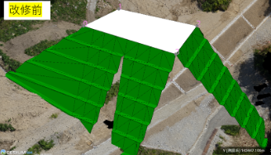
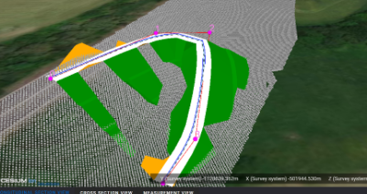
Release Item List
NO. | Target Functions | Overview
8 | Slope Formation (Bug Repair) | Overview：Failure to generate slopes only halfway up the slope. Details：A bug has been corrected where the slope did not reach the point cloud and was sometimes interrupted in the middle of the slope.
9 | Slope Formation (Bug Repair) | Overview：Failure to upload overseas coordinate point clouds converted from DXF. Details：A problem has been corrected in which point clouds with overseas coordinates converted and created via the SC Dashboard from DXF point clouds could cause abnormal point cloud uploads due to height map creation anomalies or height maps not being created.

Slide 14
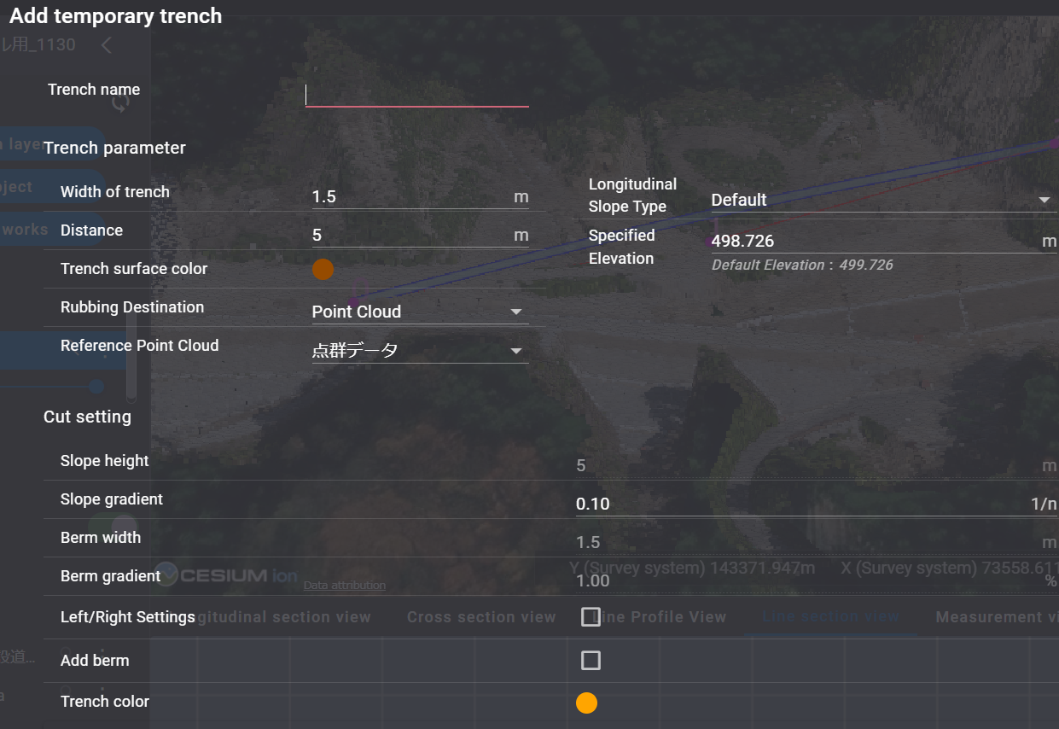
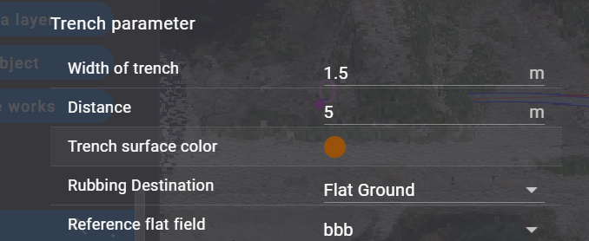
Release Item List
NO. | Target Functions | Overview
10 | Temporary Trench Drawing (Bug Repair) | Overview：Failure to set cut soil color for temporary trench . Details：A problem that prevented the setting of the “Trench color” for the cut soil setting when adding a temporary trench has been corrected.
11 | Temporary Trench Drawing (Bug Repair) | Overview：Unknown numbers were displayed when the temporary trench was leveled. Details：A problem has been corrected in which an unknown number was displayed as the initial value of the reference flat data when a flat was selected as the sliding destination in the Add/Edit temporary trench function.

Slide 15
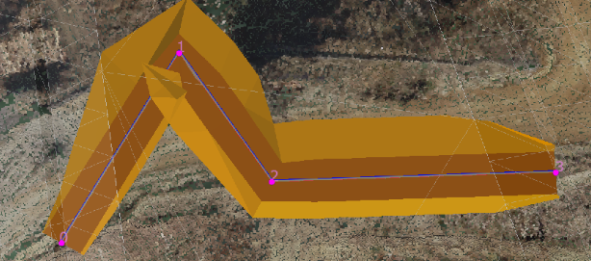
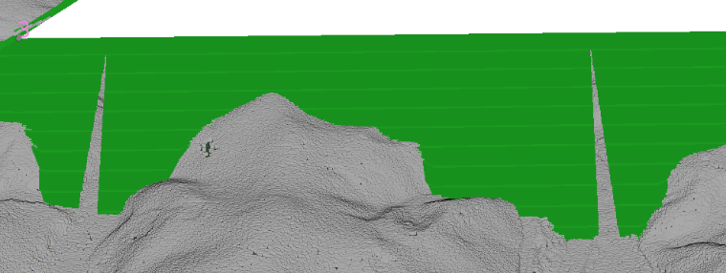
Release Item List
NO. | Target Functions | Overview
12 | Temporary Trench Drawing (Bug Repair) | Overview：When a curve was set to an acute angle in the temporary trench drawing, the shape of the slope was incorrect. Details：A problem has been corrected in which, when drawing a curve with a short distance and an acute angle and then straightening the curve, the slope shape inside the curve would be incorrect.
13 | Flat Ground Drawing (Bug Repair) | Overview：Failure to cut from the first step of the small step on the flat ground. Details：A problem that caused a cutout to be made from the first step of a small step when drawing a flat ground has been corrected.
The cut is made from the first small step.

Slide 16
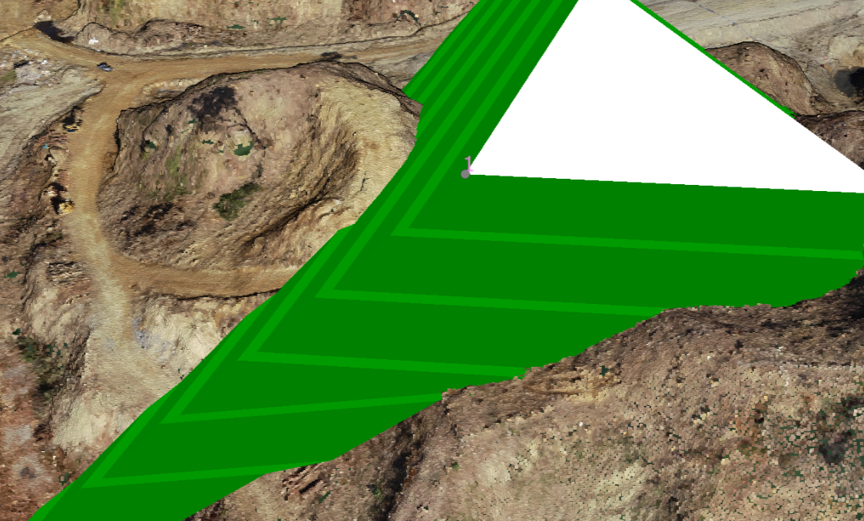
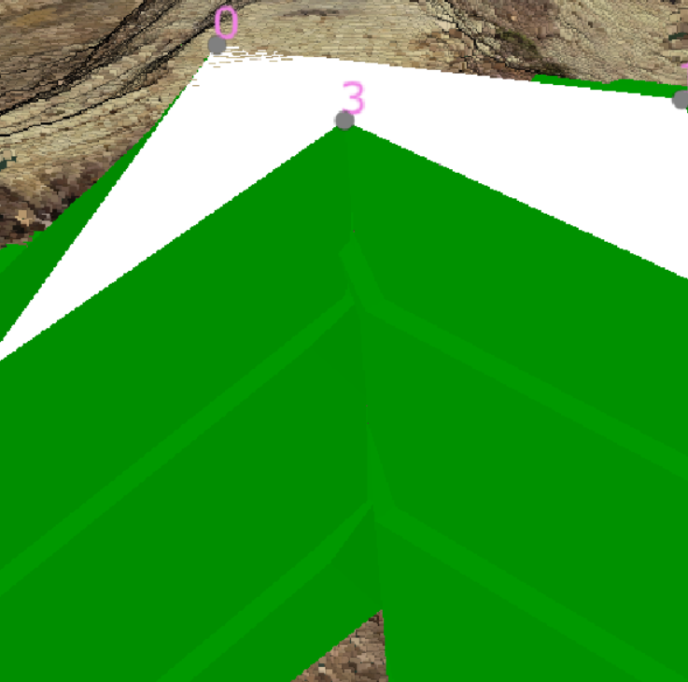
Release Item List
NO. | Target Functions | Overview
14 | Flat Ground Drawing (Bug Repair) | Overview：Failure to change the angle of small steps on a flat ground. Details：A problem with the angle of a small step changing in the middle of a slope has been corrected.
15 | Flat Ground Drawing (Bug Repair) | Overview：Defects that cause anomalies in shape when slopes face inward toward each other on level ground. Details：A problem has been corrected in which an anomaly would occur in the shape of a small step when the angle between slopes is inward in the flat ground drawing.

Slide 17
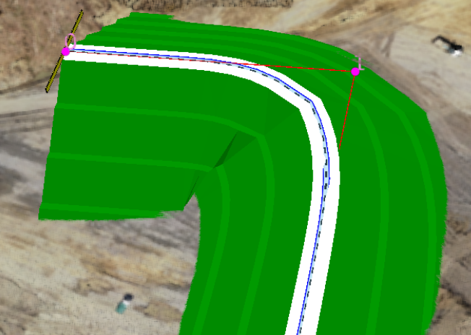
Release Item List
NO. | Target Functions | Overview
16 | Temporary Road Drawing (Bug Repair) | Overview：Defects in the shape of temporary roads when the curve angle is too steep. Details：A problem has been corrected in the drawing of temporary roads where, when the angle of a curve is steep (about 90 degrees), an anomaly occurs in the shape of the small steps of the inner slope.
17 | SIMA File (Bug Repair) | Overview：SIMA file upload error. Details：Files that cause an error when uploading SIMA files have been modified so that they can be uploaded normally.
18 | Exclusion Control Retrofit (Bug Repair) | Overview：Functional failure of the exclusion control. Details：A bug that prevented other users from editing an object in edit mode, even though the original object was in view mode when they started editing another object (or exited the site), has been fixed.

Slide 18
EOF

