Slide 1
Smart Construction Design3D 2024.6.18 (Schedule) About the Release Version

Slide 2
Release Item List
We are pleased to announce the release of updates to "Smart Construction Design3D" with the following schedule and content.
Due to system maintenance, the relevant services will not be available during the following dates.
(*The release schedule, time, and contents are subject to change depending on the situation. Please understand this in advance.)
Schedule： Tuesday, Jun 18(Japan time) 7:00 p.m. - 9:00 p.m.
NO. | Target Functions | Overview | Details
1 | Line section view Measurement view (Functional Improvement) | Modified display of line section view and measurement view. | Line section view and measurement view have been modified to show which data is displayed for each.
2 | Edit mode(Bug Repair) | Failure to edit objects in edit mode. | The following three problems (listed below) that prevented objects from being edited when another object was placed in edit mode have been fixed.
3 | Cross section view (Bug Repair) | Unable to read slope values in cross section view. | A problem has been corrected in which the slope value display could not be read when zoomed in at the first section position in the cross section view.
4 | Line section view (Bug Repair) | Line section view display height is not correct. | A problem has been corrected in which the height displayed in the line section view differs from the height of the flat and cross-sectional output.
5 | DXF data(Bug Repair) | Unnecessary linear display occurs when the DXF data is larger than the point cloud. | A problem has been corrected in which a linear line toward height 0 was displayed at the edge of DXF data larger than the point cloud when projected onto the ground surface.
6 | Design data(Bug Repair) | Failure to upload design data with large file size. | When uploading design data (XML data) with a large file size, an error message is displayed even though the design data has been uploaded.

Slide 3
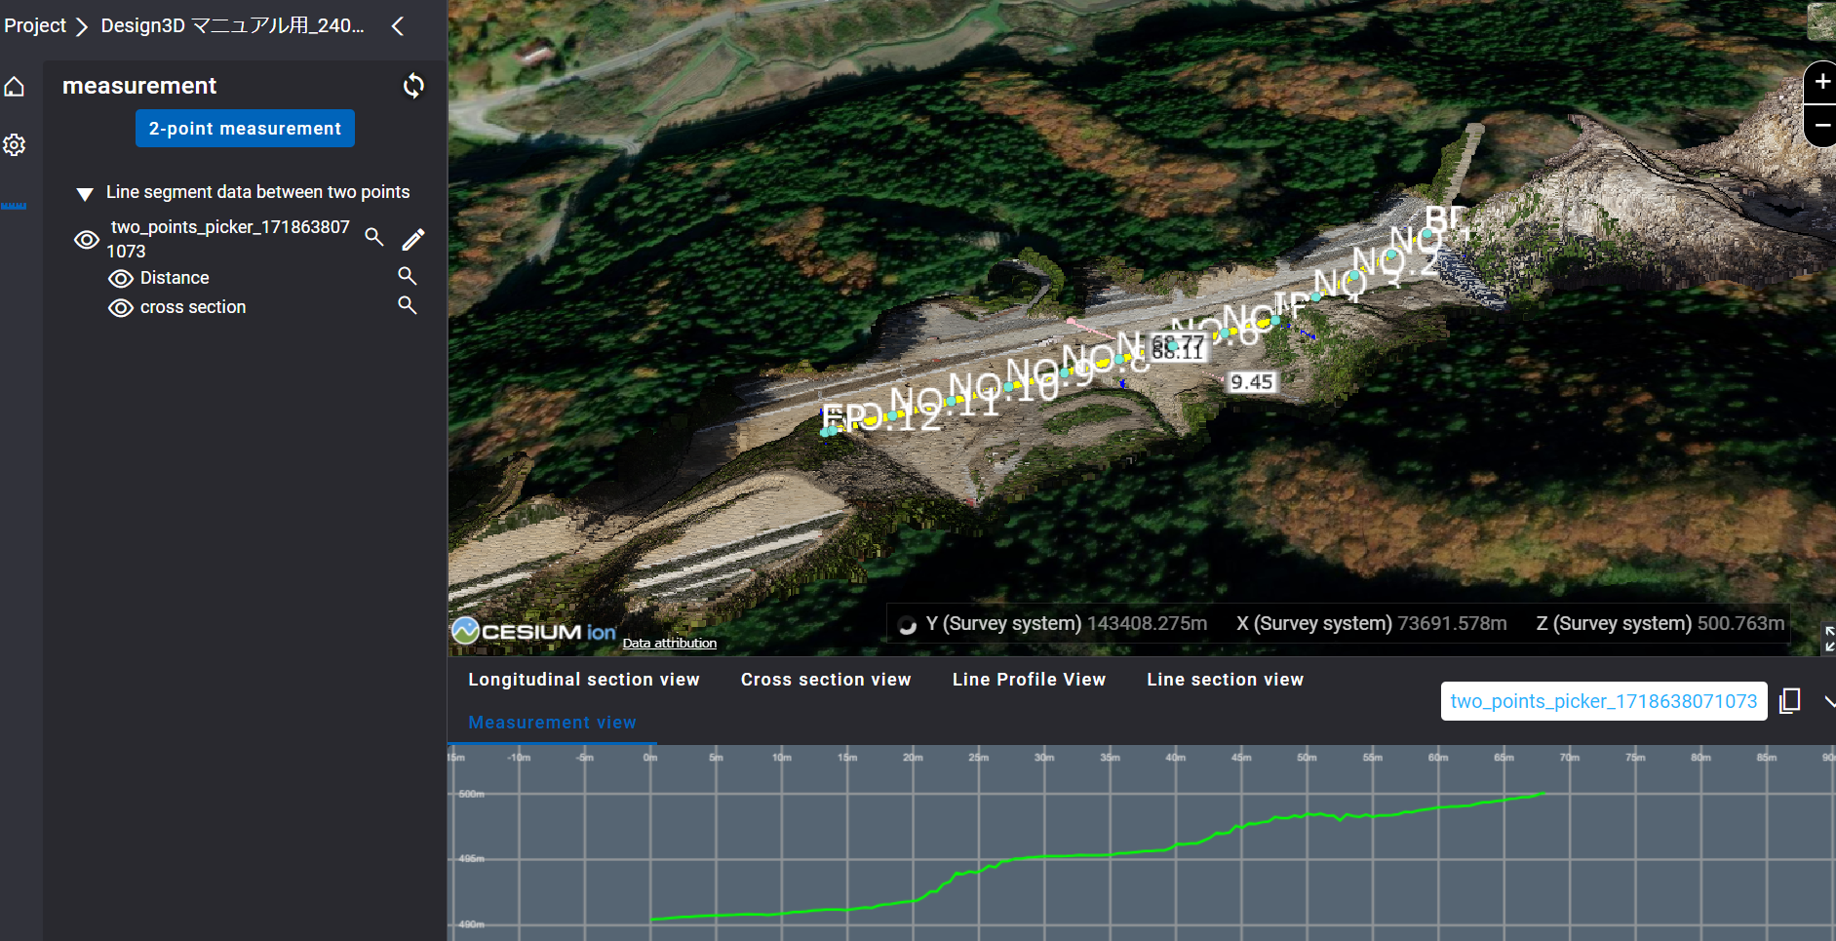
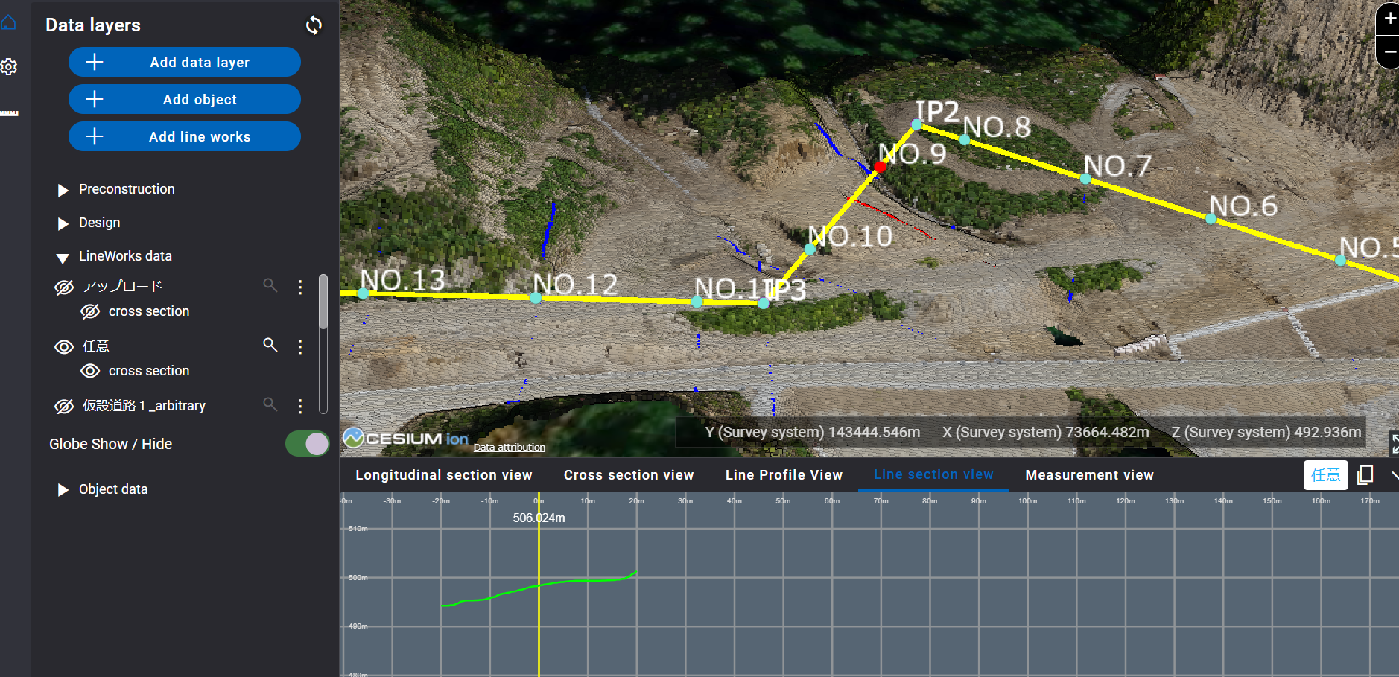
Release Item List
NO. | Target Functions | Overview
1 | Line section view Measurement view (Functional Improvement) | Overview：Modified display of line section view and measurement view. Details：Line section view and measurement view have been modified to show which data is displayed for each.
【Measurement view】
【Line section view】
Data name
Data name

Slide 4
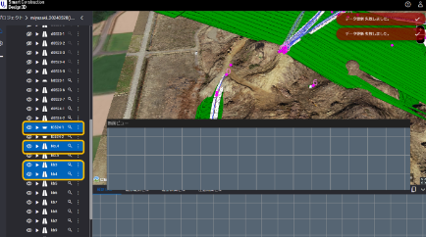
Release Item List
NO. | Target Functions | Overview
2 | Edit mode (Bug Repair) | Overview：Failure to edit objects in edit mode. Details：The following three problems (listed below) that prevented objects from being edited when another object was placed in edit mode have been fixed. The right-click menu does not appear when a reference point is moved in the 3Dview. (2) The longitudinal slope cannot be specified in the longitudinal view. (3) Objects that have been edited in the object list do not return from the blue background color to the original background color.
3 | Cross section view (Bug Repair) | Overview：Unable to read slope values in cross section view. Details：A problem has been corrected in which the slope value display could not be read when zoomed in at the first section position in the cross section view.

Slide 5
Release Item List
NO. | Target Functions | Overview
4 | Line section view (Bug Repair) | Overview：Line section view display height is not correct. Details：A problem has been corrected in which the height displayed in the line section view differs from the height of the flat and cross-sectional output.
①＝③
Only the height of the ② line section view is different.

Slide 6
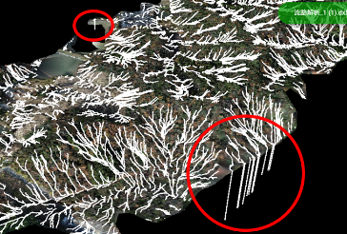
Release Item List
NO. | Target Functions | Overview
5 | DXF data (Bug Repair) | Overview：Unnecessary linear display occurs when the DXF data is larger than the point cloud. Details：A problem has been corrected in which a linear line toward height 0 was displayed at the edge of DXF data larger than the point cloud when projected onto the ground surface.
6 | Design data (Bug Repair) | Overview：Failure to upload design data with large file size. Details：When uploading design data (XML data) with a large file size, an error message is displayed even though the design data has been uploaded. The message is now displayed if the upload takes a long time.

Slide 7
EOF

