Slide 1
Smart Construction Design3D
2024.8.6 About the Release Version

Slide 2
Release Item List
We are pleased to announce the release of updates to "Smart Construction Design3D" with the following schedule and content.
Due to system maintenance, the relevant services will not be available during the following dates.
(*The release schedule, time, and contents are subject to change depending on the situation. Please understand this in advance.)
Schedule： Tuesday, August 6(Japan time) 7:00 p.m. - 9:00 p.m.
NO. | Target Functions | Overview | Details
1 | Flat ground editing (Functional Improvement) | Improved editing of flat ground to change points and planes. | The following two flat ground editing functions have been modified.
2 | Plotting function(Bug Repair) | Fixed a bug that prevented plotting when adding objects. | A problem with poor response and points not being struck when clicking to add an object has been corrected for all temporary roads, flat grounds, and floor excavations.
3 | Flat ground plotting (Bug Repair) | Fixed a bug that prevented the drawing of a flat ground without a slope. | A problem in which slopes were created even when no slopes were set in the flat ground drawing has been corrected.
4 | Cross Section View (Bug Repair) | Slopes are only displayed on one side in the cross-sectional view of temporary roads and temporary trench. | A problem in which only one side of the slope was displayed when a section view was displayed after drawing a temporary roads and temporary trench has been corrected.

Slide 3
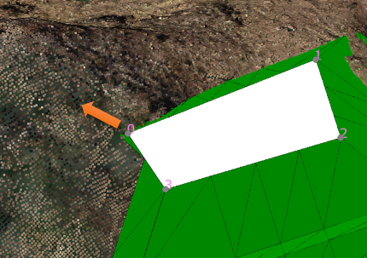
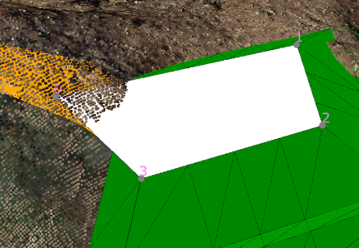
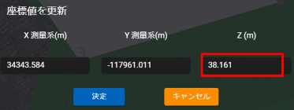
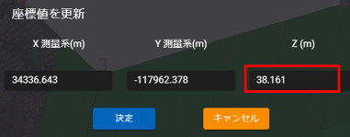
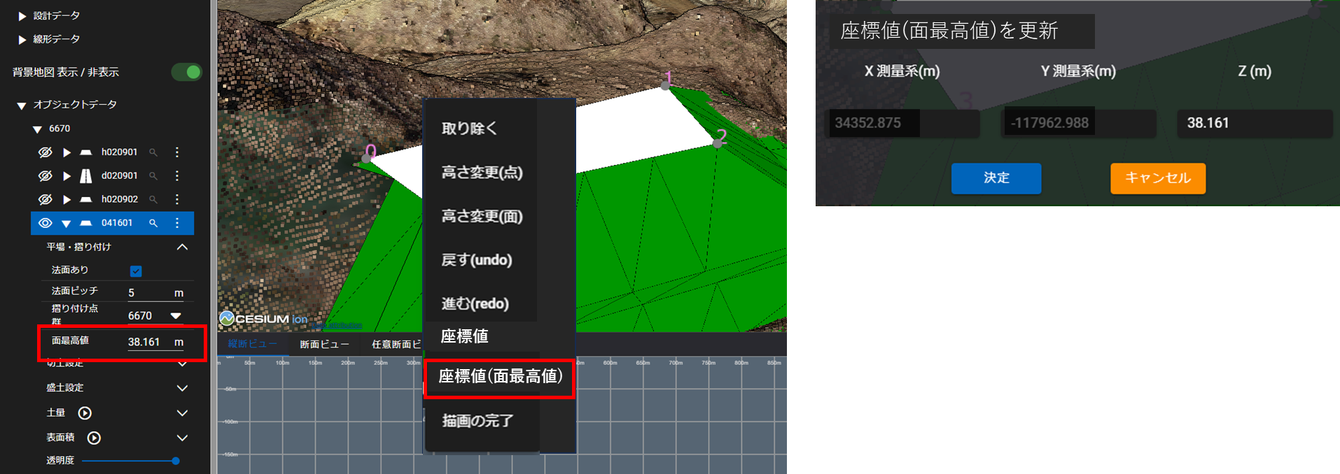
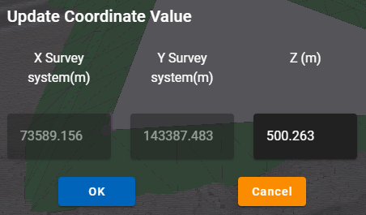
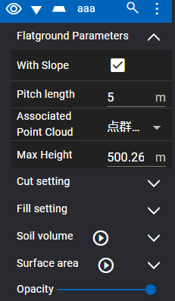
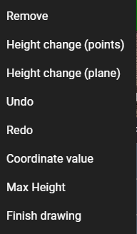
Release Item List
NO. | Target Functions | Overview
1 | Flat ground editing (Functional Improvement) | Overview：Improved editing of flat ground to change points and planes. Details：The following two flat ground editing functions have been modified.
(1) Do not change the height Z value by moving the reference point.
(2) Make “Max Height” in the left menu uneditable, and add “Max Height(Highest value of surface)” to the right-click menu to display the coordinate value screen and allow Z(m) to be modified (X and Y cannot be modified).

Slide 4
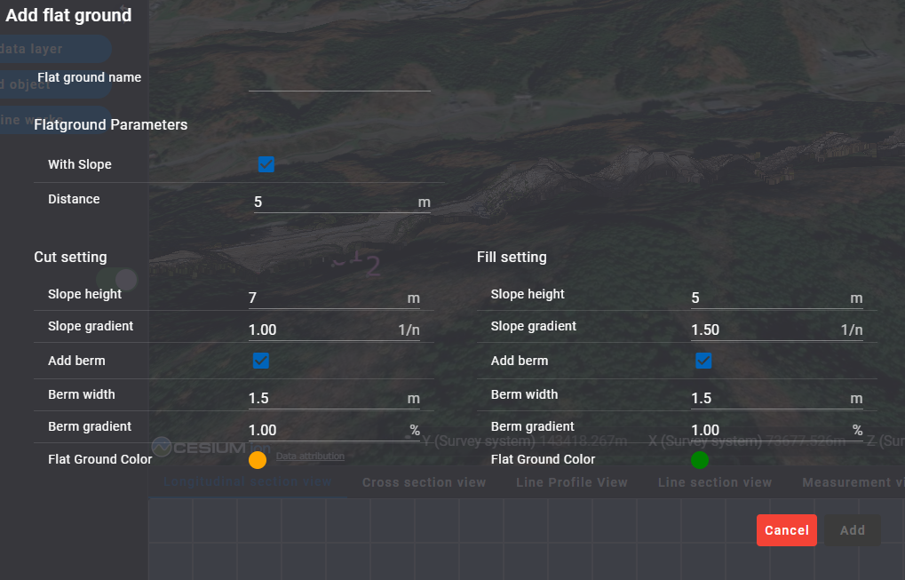
Release Item List
NO. | Target Functions | Overview
2 | Plotting function (Bug Repair) | Overview：Fixed a bug that prevented plotting when adding objects. Details：A problem with poor response and points not being struck when clicking to add an object has been corrected for all temporary roads, flat grounds, and temporary trenchs.
3 | Flat ground plotting (Bug Repair) | Overview：Fixed a bug that prevented the drawing of a flat ground without a slope. Details：A problem in which slopes were created even when no slopes were set in the flat ground drawing has been corrected.

Slide 5
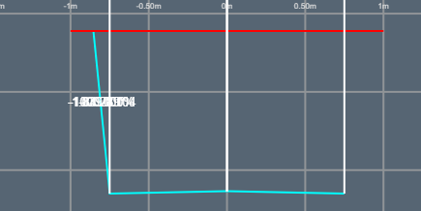
Release Item List
NO. | Target Functions | Overview
4 | Cross Section View (Bug Repair) | Overview：Slopes are only displayed on one side in the cross-sectional view of temporary roads and temporary trench. Details：A problem in which only one side of the slope was displayed when a section view was displayed after drawing a temporary roads and temporary trench has been corrected.

Slide 6
EOF

