Slide 1
Smart Construction Design3D 2024.9.3 (Schedule) About the Release Version

Slide 2
Release Item List
We are pleased to announce the release of updates to "Smart Construction Design3D" with the following schedule and content.
Due to system maintenance, the relevant services will not be available during the following dates.
(*The release schedule, time, and contents are subject to change depending on the situation. Please understand this in advance.)
Schedule： Tuesday, September 3(Japan time) 7:00 p.m. - 9:00 p.m.
NO. | Target Functions | Overview | Details
1 | View Status (Functional Improvement) | Save the display state of point cloud data and design data. | If a project is closed with point cloud data and design data displayed in the 3D View, the next time the same project is opened, the displayed point cloud data and design data will be automatically displayed in the 3D View.
2 | Lineworks data(Bug Repair) | Fixed a bug in displaying/hiding line works data. | A problem has been corrected where, after displaying line works data and then displaying a cross section, if the linear data was hidden or the cross section was hidden, it could not be displayed again.
3 | Lineworks data(Bug Repair) | Fixed a problem in which the angle of the section line was not perpendicular to the right angle in line works creation. | All points are at the same section line angle (perpendicular to the line segment extending from the point) as BP and EP, which has been modified to be perpendicular to the change point.
Please take the following actions in response to the No. 3 bug fix.
Existing linear data is reflected by the operation of the three-point leader > “Edit Cross Section” > “Edit” of the linear data.

Slide 3
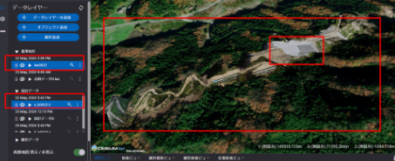
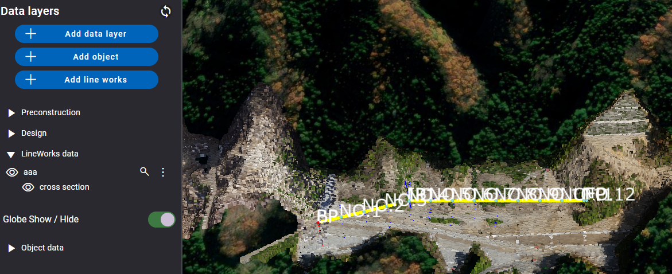
Release Item List
NO. | Target Functions | Overview
1 | View Status (Functional Improvement) | Overview：Save the display state of point cloud data and design data. Details：If a project is closed with point cloud data and design data displayed in the 3D View, the next time the same project is opened, the displayed point cloud data and design data will be automatically displayed in the 3D View.
2 | Lineworks data (Bug Repair) | Overview：Fixed a bug in displaying/hiding line works data. Details：A problem has been corrected where, after displaying line works data and then displaying a cross section, if the linear data was hidden or the cross section was hidden, it could not be displayed again.
Show/Hide behavior has been modified to be correct

Slide 4
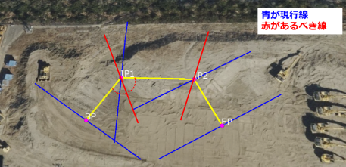
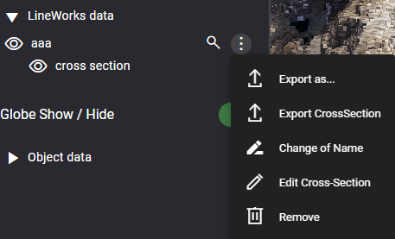
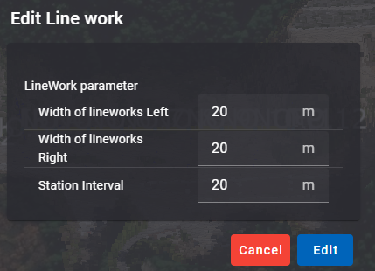
Release Item List
NO. | Target Functions | Overview
3 | Lineworks data (Bug Repair) | Overview：Fixed a problem in which the angle of the section line was not perpendicular to the right angle in line works creation. Details：All points are at the same section line angle (perpendicular to the line segment extending from the point) as BP and EP, which has been modified to be perpendicular to the change point.
Blue is current
Red is after renovation
Please take the following actions in response to the No. 3 bug fix.
Existing linear data is reflected by the operation of the three-point leader > “Edit Cross Section” > “Edit” of the linear data.

Slide 5
EOF

