Slide 1
Smart Construction Design3D 2024.10.8 (Schedule) About the Release Version

Slide 2
Release Item List
We are pleased to announce the release of updates to "Smart Construction Design3D" with the following schedule and content.
Due to system maintenance, the relevant services will not be available during the following dates.
(*The release schedule, time, and contents are subject to change depending on the situation. Please understand this in advance.)
Schedule： Tuesday, October 8(Japan time) 7:00 p.m. - 9:00 p.m.
NO. | Target Functions | Overview | Details
1 | Cross Section View (Bug Repair) | Fixed a bug in which only one side of the slope was displayed in the cross-sectional view of temporary roads and floor excavations. | A problem in which only one side of the slope was displayed when checking the cross-sectional view of a plotted temporary road or floor excavation has been corrected.
2 | Operation Manual (Bug Repair) | Fixed a bug that the operation manual was not displayed. | “?” icon does not display the operation manual has been fixed.

Slide 3
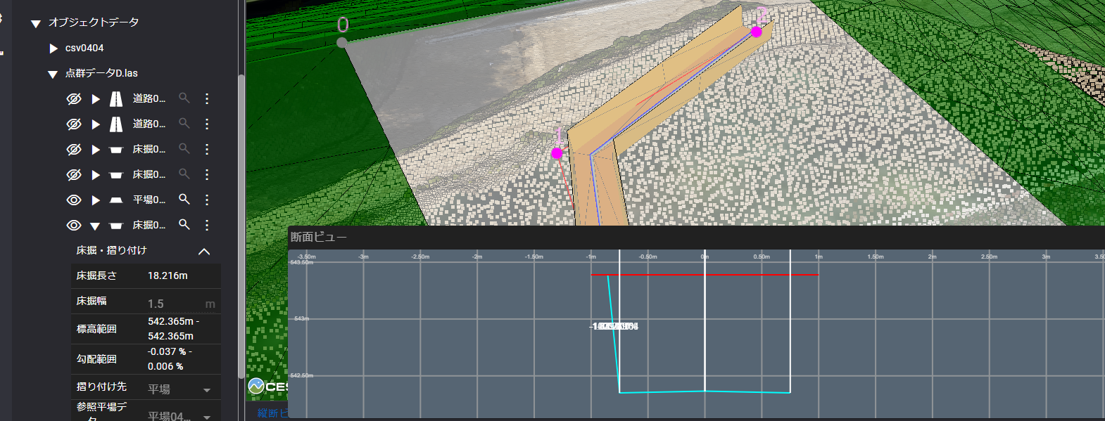
Release Item List
NO. | Target Functions | Overview
1 | Cross Section View (Bug Repair) | Overview：Fixed a bug in which only one side of the slope was displayed in the cross-sectional view of temporary roads and floor excavations. Details：A problem in which only one side of the slope was displayed when checking the cross-sectional view of a plotted temporary road or floor excavation has been corrected.
2 | Operation Manual (Bug Repair) | Overview：Fixed a bug that the operation manual was not displayed. Details：“?” icon does not display the operation manual has been fixed.
Only one side of the slope is shown.

Slide 4
EOF

