Slide 1
Smart Construction Design3D 2024.10.22 About the Release Version

Slide 2
Release Item List
We are pleased to announce the release of updates to "Smart Construction Design3D" with the following schedule and content.
Due to system maintenance, the relevant services will not be available during the following dates.
(*The release schedule, time, and contents are subject to change depending on the situation. Please understand this in advance.)
Schedule： Tuesday, October 22(Japan time) 7:00 p.m. - 9:00 p.m.
NO. | Target Functions | Overview | Details
1 | Line data(Bug Repair) | Fixed a bug that caused section lines in design data to be created incorrectly. | Creating a section line of linear data on design data causes the section line to be wavy; this has been corrected so that the section line is created to match the outline of the design data as well as the object section line.

Slide 3
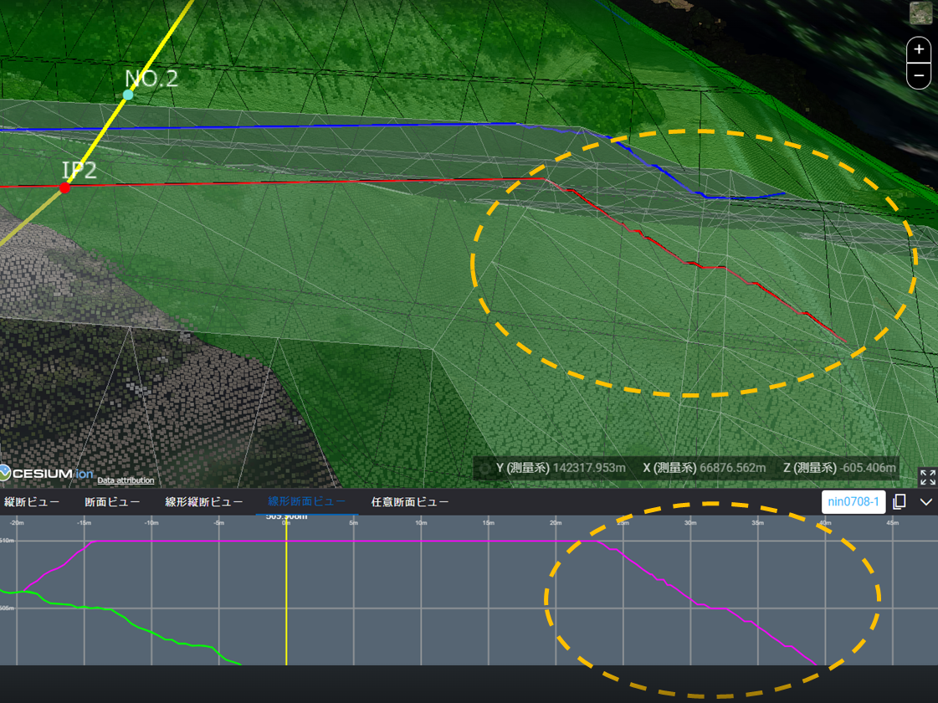
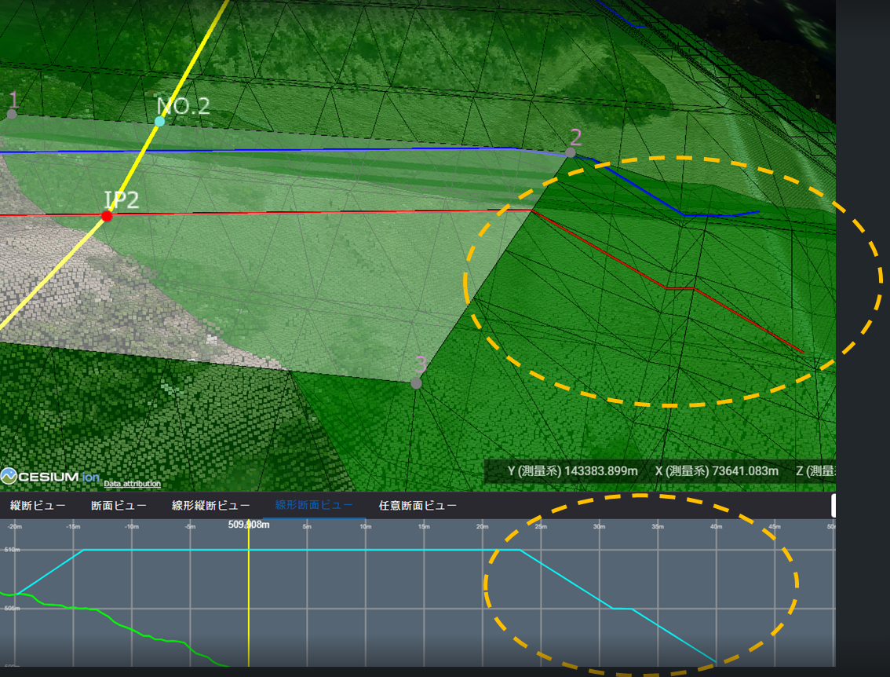
Release Item List
NO. | Target Functions | Overview
1 | Line data (Bug Repair) | Overview：Fixed a bug that caused section lines in design data to be created incorrectly. Details：Creating a section line of linear data on design data causes the section line to be wavy; this has been corrected so that the section line is created to match the outline of the design data as well as the object section line.
【 Cross-section line of design data 】
【 Cross-section line of an object 】

Slide 4
EOF

